Slide 1
Playing with Polymers
8th Grade Science Mrs. Tracy Trimpe Havana Junior High School

Slide 2
Table of Contents
Quick Links
Polymer Notes
Safety Rules
Oobleck
Gloop
Slime Tests
Boogers
Goobers
Super Slime
Final Instructions

Slide 3
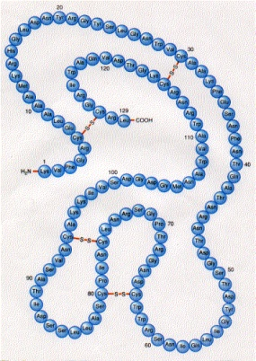
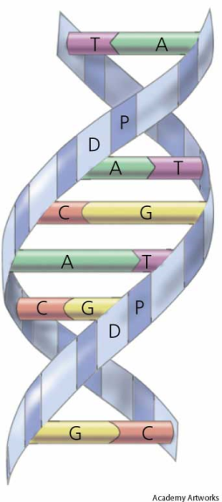
1. What is polymerization?
Polymerization is the process of chemically bonding monomers to form polymers.
Monomers
Polymer
2. What are some examples of natural polymers?
Cotton, silk, wool, and natural rubber are all natural polymers made from plant or animal products.
Protein is an essential ingredient in living matter and is made up of monomers called amino acids. It is also called a polypeptide chain.
The DNA found in our cells is also a polymer. The monomer units of DNA are nucleotides and the polymer is known as a polynucleotide.
Polypeptide Chain
DNA
Images: Top - http://bioinfo.bact.wisc.edu/themicrobialworld/lysozyme.gif Bottom: http://haplogroup-i.com/img/A4dna.jpg

Slide 4
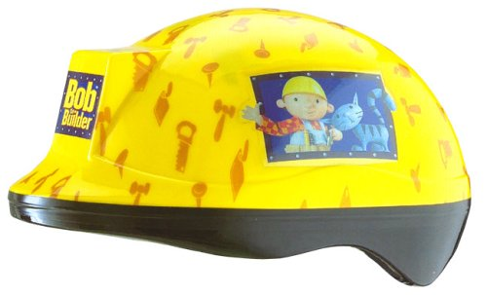
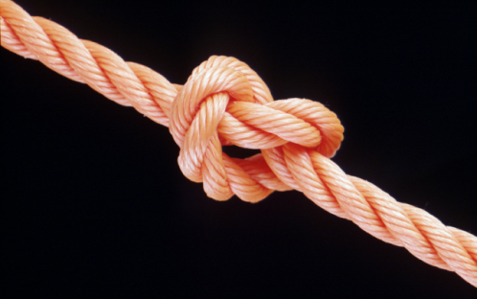
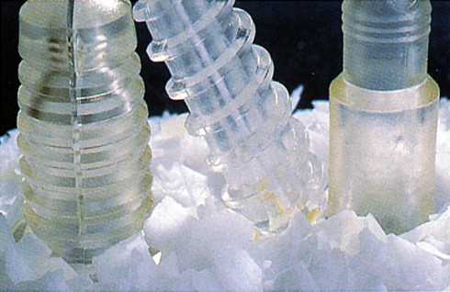
3. What are some examples of synthetic (manmade) polymers?
Some synthetic polymers are manmade rubber and fabrics such as polyester, nylon, and rayon.
Plastic is a synthetic polymer used to make a variety of products, such as water bottles, plastic wrap, and kitchen utensils as well as safety gear, computers, and rocket engines.
Polymers are also used in medicine as substitutes for human tissues, such as bones and arteries.
4. What substances are used to make synthetic polymers?
They are made from materials called petrochemicals, which are made from petroleum Petroleum is made from the remains of plants and animals that have been buried beneath sediments at the bottom of the ocean. Over time, heat and pressure change the remains into petroleum, which is a nonrenewable resource .
Safety Helmet
Nylon Rope
Pins & screws used to
hold together bones

Slide 5
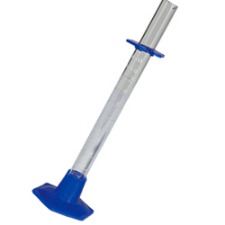
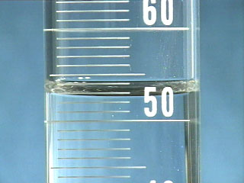
Measuring Volume #5
Graduated Cylinders
Leave the guard at the top of the cylinder!
Instrument used to measure volume
Marked with a scale in milliliters
Be sure to check the scale for each cylinder!
Meniscus – “Bubble” that forms at the top of the liquid in a graduated cylinder.
Measure from the BOTTOM of the meniscus.

Slide 6
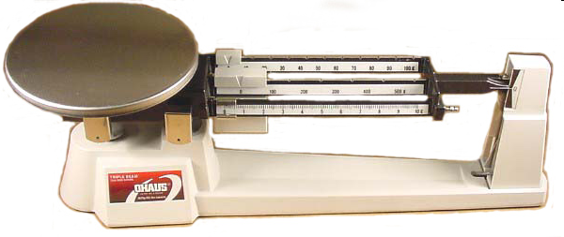
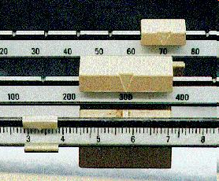
Measuring Mass #6
Triple-Beam Balance
Instrument used to measure mass
Marked with a scale in grams
Place the object on the scale and then move the weights on the beams until you get the lines on the right-side of the scale to match up.
Once you have balanced the scale, you add up the amounts on each beam to find the total mass.
What would be the mass of the object measured in the picture?
_______ + ______ + _______ = ________ g
Top Image: http://www.southwestscales.com/Ohaus_Triple_Beam_750-SO.jpg Bottom Image: http://www.regentsprep.org/Regents/biology/units/laboratory/graphics/triplebeambalance.jpg

Slide 7
Safety Rules
#7
Read directions carefully! If you are not sure what to do, ask for help. Do not make up your own recipes!
(2) Goggles should always be worn when experimenting with chemicals.
(3) Do not smell directly from the container! If you need to sniff a slime, hold it several inches away from your face and use your hand to wave fumes towards your nose.
(4) No eating or drinking during the lab. This also means that you should NOT eat the slime or taste any substances used to make slime! Keep your slime out of reach of small children and pets.
Do not put the slime where it doesn’t belong, such as on clothing, carpeting, or other people!
(6) Dispose of slime materials properly. All slime must be thrown away in the trash can. Use a dry towel to clean your hands, cup, and plate. DO NOT put any amount of slime in the sink!
(7) Clean up messes immediately! Your lab area should be clean when you start and clean when you leave.

Slide 8
Safety Rules – Cont’d
(8) Wash your hands before you leave class.
(9) Behave! No hitting, shoving, or other horseplay is allowed!
Slime must remain in the classroom! You are not allowed to take it to other classes. You will be able to take the slime home on the last day!
(11) Most of the slime will keep for 3-4 days. After your slime goes bad, throw it away! Do not dump in a sink!
(12) If you do not follow the rules, you will not be allowed to do the experiments and will earn a zero grade for this unit.
To show that you agree to follow these safety rules, sign your name in the box on your note worksheet.

Slide 9
Oobleck
Work in pairs – Each pair will make a batch!
This is a mixture made from corn starch and water. Corn starch is a natural polymer made from corn. The plastic bin on your table and the other plastic materials we will use are synthetic (man-made) polymers.
Directions:
1 – Fill a small plastic cup with corn starch and dump it onto a large plate.
2 – Fill the small plastic cup with water.
3 – Use your hands to slowly mix the water into the corn starch a little at a time until you get a gooey mixture. Don’t add too much water!
Too runny? Add a scoop of corn starch to thicken it up. Too thick/crumbly? Add a few drops of water to make it thinner.
4 – Experiment with your oobleck to answer the questions on the next page.

Slide 10
Think About It!
1 – What happens when you slowly push on the Oobleck?
2 – What happens when you quickly push on the Oobleck?
3 – Can you roll it into a ball? If so, how long does it take to spread out when you set it on plate?
4 – What happens when you hold it above the plate and let it “hang”?
5 – Is Oobleck a solid or a liquid?
Done? 1 - Clean up your area. 2 - Put your plate of Oobleck back on the side table.
Table of Contents

Slide 11
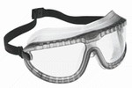
Gloop
This is a polymer made from white glue and sodium tetraborate.
White glue is made with polyvinyl alcohol, or PVA, which is a plastic made from oil. Borax is a natural mineral mined from the earth, which is made of boron, sodium, oxygen, and water. It is used as a laundry agent and cleaning product.
When you add water to glue, the PVA starts to dissolve in the water. When you add the borax solution, it reacts with the PVA to crosslink. This crosslinking causes the gunk to undergo an irreversible gel-like reaction and forms the substance we call Gloop.
Each person will make a batch!
Don’t forget your goggles!

Slide 12
Gloop - Get your materials …
From the side counter: 1 bottle of GLUE 1 small RED graduated cylinder 1 small RED dot beaker of BORAX solution 1 eyedropper with RED band 1 medium GREEN graduated cylinder 1 small GREEN dot beaker with water
1 eyedropper (not a red-banded one)
From your table box:
2 small cups (1 for each person)
2 wooden stir sticks (1 for each person) 2 small bags (1 for each person)
1 ruler
1 black marker
Work in pairs. Each person will make a batch!
Don’t forget your goggles!

Slide 13
1 – Use a ruler to make a mark that is 1 cm from the bottom of a small cup.
2 – Pour white glue into your cup until you reach the 1 cm mark.
3 – Add 2 drops of food coloring to the glue and stir well with the wooden stick.
4 – Use a clean graduated cylinder to measure out 7 ml of water and add it to the glue. Mix well.
5 – Use a clean graduated cylinder to measure out 8 ml of borax solution. Add it to the glue mixture and stir.
6 - Once the Gloop is formed, remove it from the cup and knead it with your hands for several minutes. It should start to form a nice blob after a few minutes.
Too sticky? Add borax (one drop at a time) Too stringy? Add glue (one small squirt at a time)
7 - Put your Gloop into a small plastic bag. Use a marker to label your bag of slime and place in the correct area.
8 - Use a dry paper towel to wipe out your cup and clean your hands. Save the cup for the next slime. Do not wash your cup or hands in the sink until you have wiped off all of the slime gunk!

Slide 14
Have extra time?
Start your slime tests and fill in your data chart or work on your puzzle page.
Don’t forget to do your
Slime Tests
End of Class? Time to clean up!
1 – Clean all equipment.
2 – Clean up your table and wash your hands.
3 – Restock your supplies basket.
4 – Put goggles back in the plastic sleeve and put away.
Table of Contents

Slide 15
Slime Tests
Fill in your data chart as you do the tests! NOTE: If you cannot do a test, indicate that in the box on the data sheet.
Description – How does your slime look like, feel, smell (waft), etc.?
Slime Rating – Rate it from 1 = not very slimy to 5 = very slimy
Slow Poke Test – Roll the slime into a ball and slowly poke your finger into the slime. What happens? Does your finger go into the goop?
Quick Poke Test – Roll the slime into a ball and quickly poke the slime with your finger. What happens? Does your finger go into the goop?
Slow Pull Test – Roll the slime into a ball and slowly pull on the ends with your fingers. What happens? Write your observations on your worksheet.
Quick Pull Test - Roll the slime into a ball and slowly pull on the ends with your fingers. What happens? Write your observations on your worksheet.
Blob Test – Grab a timer. Roll your slime into a ball and sit it on your plate or the table. How long does it take for it to flatten out?
Hang Test - Grab a timer and a ruler. Roll your slime into a ball and hold it at a height of 30 cm above the table. Time how long it takes for the goop to reach the table.
Bounce Test - Roll your slime into a ball and drop from a height of 30 cm above the table. What happens? Write your observations (how high it bounces) on your worksheet.
Table of Contents

Slide 16
Boogers
This is a polymer made from white glue and laundry starch.
Laundry starch is a polymer in water, but becomes rigid when it dries. It is used to help fabric resist wrinkling.
This one can be very messy!
1 - Don’t dump it out of the cup until you have a good blob that doesn’t stick to everything!
2 - Don’t allow it to get too stringy when doing the slime tests!
You will make 1 batch and share it with your partner!
Don’t forget your goggles!

Slide 17
Boogers - Get your materials …
From the side counter: 1 bottle of GLUE 1 medium YELLOW graduated cylinder 1 small YELLOW dot beaker with starch
From your table box:
1 small cup (per group)
1 wooden stir stick 2 small bags (1 for each person)
1 ruler
1 black marker
Work in pairs. Each pair will make a batch and split it!
Don’t forget your goggles!

Slide 18
1 - Place 1 cm of white glue into the bottom of your plastic cup.
2 – Add 2-3 drops of food coloring and mix well.
3 – Use a graduated cylinder to measure out 15 ml of the laundry starch. Have your partner stir as you pour the starch into the glue.
4 - Once the Boogers are formed, remove from the cup and knead with your hands for several minutes. Don’t take it out of the cup if it’s still too sticky!
Too sticky? Add starch (one drop at a time) Too stringy? Add glue (one squirt at a time)
5 - Split your sample in half and put into small plastic bags. Use a marker to label your bag of slime and place in the correct area.
6 - Use a dry paper towel to clean your hands. You can throw your cup away. Do not wash your hands in the sink until you have wiped off all of the slime gunk!

Slide 19
Have extra time?
Finish any slime tests that you have not completed or work on your puzzle page.
Don’t forget to do your
Slime Tests
End of Class? Time to clean up!
1 – Clean all equipment.
2 – Clean up your table and wash your hands.
3 – Restock your supplies basket.
4 – Put goggles back in the plastic sleeve and put away.
Table of Contents

Slide 20
Goobers
This is a polymer made from guar gum and sodium tetraborate.
Guar gum is used as a thickening agent in many foods and other substances, such as toothpaste, yogurt, and gravies or sauces.
WARNING: This one is the toughest slime to make and can be quite a mess!
1 - Make sure to keep it on a plate or in your hands!
2 – Give it some time to set up!
3 – You may have to let it sit overnight to “gel”.

Slide 21
Goobers - Get your materials …
From the side counter: 1 small CUP labeled “GUAR GUM” 1 small CONTAINER of GUAR GUM 1 small RED graduated cylinder 1 small RED dot beaker of BORAX solution 1 eyedropper with RED band 1 medium GREEN graduated cylinder 1 small GREEN dot beaker of water 1 eyedropper (not a red-banded one)
From your table box:
1 small cup* 2 small bags
1 black marker Food coloring
* Reuse one of your small cups from the Gloop experiment.
Work in pairs. Each pair will make a batch and split it!
Don’t forget your goggles!

Slide 22
1 – Place the plastic cup labeled “Guar Gum” on a triple-beam balance and find the mass of the cup.
2 – Add 0.6 to the measurement and adjust the scale to the new number. Use a clean stir stick to add the guar gum powder into the cup a little bit at a time until you get the scale to balance. It won’t take very much!
3 - Use a clean graduated cylinder to measure out 40 ml of water and pour into a clean plastic cup – not the one with the powder.
4 - Have your partner stir the water as you sprinkle the guar gum into it a little at a time to keep it from clumping. If it does clump, break up the clumps with the stick and stir until dissolved. Keep stirring until the mixture thickens. Do not do the next step until the mixture has thickened!
5 - Add food coloring and stir well.
Funky Slime
1 drop of green
2 drops of yellow
Throat Junk
1 drop of green
2 drops of yellow
1 drop of red
Blood Clot
6 drops of red
1 drop of green
1 drop of yellow
Diarrhea
2 drops red
2 drops yellow
1 drop blue

Slide 23
6 - Use a clean graduated cylinder to measure 12 ml of borax solution. Pour it into the cup and stir.
The mixture should “gel” in a few minutes. If not, continue adding borax solution (a few drops at a time) until the Goobers start to hold together. You should be able to stick your finger in the Goobers and not have a lot of it stick to your finger. You might need to let it sit for five minutes (or longer) if it doesn’t want to gel!
7 - Split your sample in half and put into small plastic bags. Use a marker to label your bag of slime and place in the correct area.
8 - Use a dry paper towel to clean your hands. You can throw the cup away. Do not wash your hands in the sink until you have wiped off all of the slime gunk!

Slide 24
Have extra time?
Finish any slime tests that you have not completed or work on your puzzle page.
Don’t forget to do your
Slime Tests
End of Class? Time to clean up!
1 – Clean all equipment.
2 – Clean up your table and wash your hands.
3 – Restock your supplies basket.
4 – Put goggles back in the plastic sleeve and put away.
Table of Contents

Slide 25
Super Slime
This is a polymer made from PVA (polyvinyl alcohol) solution and sodium tetraborate (Borax).
PVA is used to make artificial sponges, hoses, printing inks, and lubricating solutions for contact lenses. It is also found in glue! We have used the sodium tetraborate for other slimes.
Mix up a batch of Super Slime and see what happens!
Each person can make a batch!
Don’t forget your goggles!

Slide 26
Super Slime - Get your materials …
From the side counter: 1 small RED graduated cylinder 1 small RED dot beaker of BORAX solution 1 eyedropper with RED band 1 small graduated cylinder with a PVA label 1 small BLUE dot beaker of colored PVA solution
From your table box:
2 wooden stir sticks 2 small bags
2 small cups (or reuse an old one if you can) 1 black marker
Each person will make a batch of their own!
Don’t forget your goggles!

Slide 27
1 – Use a clean graduated cylinder to measure out 20 ml of the PVA solution and pour into a clean plastic cup.
2 - Use a clean graduated cylinder to measure out 4 ml of Borax solution and pour it into the cup. Stir with a stick.
Too sticky? Add borax (one drop at a time) Too crumbly? Add PVA (one drop at a time)
3 - Once the Super Slime is formed, remove from the cup and knead with your hands for several minutes to get it to the right slime consistency.
4 - Put your Super Slime into a small plastic bag. Use a marker to label your bag of slime and place in the correct area.
5 - Use a dry paper towel to wipe out your cup and clean your hands. Save the cup if you want to make another batch of slime. Do not wash your cup or hands in the sink until you have wiped off all of the slime gunk!

Slide 28
Have extra time?
Finish any slime tests that you have not completed or work on your puzzle page.
Don’t forget to do your
Slime Tests
End of Class? Time to clean up!
1 – Clean all equipment.
2 – Clean up your table and wash your hands.
3 – Restock your supplies basket.
4 – Put goggles back in the plastic sleeve and put away.
Table of Contents

Slide 29
Done making slime?
The Playing with Polymers packet is due on ______________________.
You need to: 1 – Complete all of the note page, 2 – Finish the puzzles, and 3 – Fill in all the sections on your data chart.
After you have completed all your work AND had it checked by the teacher, you may make 1 more batch of slime!
Be sure to clean up after yourself!
Table of Contents

