Slide 1
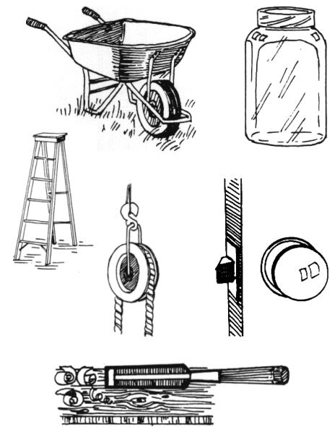
Simply Machines
Identify each simple machine.
Jar Lid
A. ________________
B. ________________
F. ________________
G. ________________
C. ________________
D. ________________
E. ________________
Wood Chisel
T. Tomm 2021 https://sciencespot.net
http://www.sciencetech.technomuses.ca/english/schoolzone/images/machsimp1.jpg

Slide 2
The answers are …
LEVER
Jar Lid
A. ________________
WHEEL & AXLE
B. ________________
Screw
F. ________________
INCLINED PLANE
C. ________________
WHEEL & AXLE
G. ________________
PULLEY
D. ________________
WEDGE
E. ________________
Wood Chisel
http://www.sciencetech.technomuses.ca/english/schoolzone/images/machsimp1.jpg

