Slide 1
Sandwich Science
Investigating Classification
Is a hot dog a sandwich?
This Photo by Unknown Author is licensed under CC BY
Nature of Science Unit
7th & 8th Grade Science
Presentation by T. Tomm 2019 http:/sciencespot.net/

Slide 2
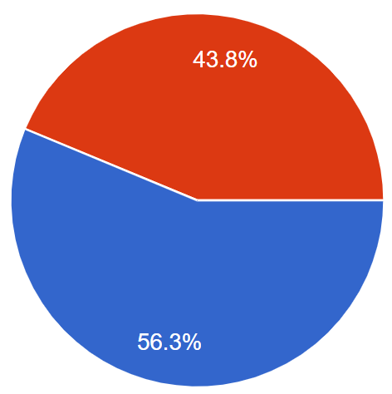
Is a hot dog a sandwich?
Your results are:
This Photo by Unknown Author is licensed under CC BY
Notes:
The results were based on replies to the, “Is a hot dog a sandwich?” question on my First Week Survey on Google Forms. Survey your students and then edit this slide with information from your students.

Slide 3
How can we decide if a hot dog is a sandwich?
What is your definition for a hot dog?
Is it a specific type of meat or shape?
Does it include a bun/bread?
Are there other qualifications/limitations?
Group Discussion
Did you base your decision on evidence?
If so, what “proof” do you have?
Is this proof credible (believable/based on data)?
Let’s take a look at science in action …
Notes:
Note: This slide is NOT included in the digital version of student INB. It is used to facilitate a discussion regarding classification.

Slide 4
Part A: Science in Action
Watch the video to help you complete this page.
What type of organism was found in the cave?
2. True or False? The process of science always follows a linear (or straight) path from start to finish.
3. What is a hypothesis?
How did scientists determine the trogloraptor was a new species?
5. How did it get its name (i.e. what specific body part)?
6. Into what family is the trogloraptor spider classified?
7. Complete this section: We all do ________________ every day. We make _________________, ask _________________, _________________ with people we know about our ideas, and come back to those original ____________. _________________ can do science - not just scientists!
8. List three ways the scientists shared their knowledge and ideas.
EDPuzzle video – “Science in Action”

Slide 5
Part A: EDPuzzle: Science in Action Answer Key
1. What type of organism was found in the cave?
2. True or False? The process of science always follows a linear (or straight) path from start to finish.
3. What is a hypothesis?
4. How did scientists determine the trogloraptor was a new species?
Arachnid
Think About It: How is a pinball game a better description of the scientific process?
An educated guess or possible answer to a question based on our observations and knowledge.
They did a detailed study of all the spider species that have been identified and found it did not match any of those.
Video Link: https://edpuzzle.com/media/5d5d4bd13284f3407c9a6dac

Slide 6
5. How did it get its name (i.e. what specific body part)?
6. Into what family is the trogloraptor spider classified?
7. Complete this section: We all do _______ every day. We make _____________, ask ___________, ______________ with people we know about our ideas, and come back to those original________. _______________ can do science - not just scientists!
8. List three ways the scientists shared their knowledge and ideas.
Its name came from the unique design of its claw
Goblin spider (New family)
science
observations
questions
communicate
ideas
Everyone
What did you say?

Slide 7
Part B: Sandwich Science
1. Write a definition for “sandwich” as it is used in the sentence.
I had a sandwich for lunch.
2. Compare your definition with a classmate. What did you have in common?
3. Would either “hot dog” in the following sentence be considered sandwiches? Explain.
My dad grilled hot dogs last night, which I used to make hot dogs with chili for supper.

Slide 8
What details did your definitions have in common?
1 – A sandwich was food.
2 – A sandwich had a filling of some sort.
3 – A sandwich had to include at least one piece of bread/pastry.
Work as a class to develop a class definition for a sandwich. Record it in the space below.
Group Discussion
A sandwich is a food consisting of 1 or more pieces of bread (or other pastry) with a filling.
Pastry = baked product?
Notes:
Note: This slide is NOT included in the digital version of student INB. I use this slide to facilitate class discussion. I record the responses on the screen while students share and discuss. Your class definition may vary depending on student reponis

Slide 9
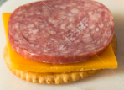
Based on our class definition of a sandwich, drag each item to classify it in the chart.
Subway Sub
Taco
Pig in a Blanket
PB&J
Poptart
Chicken strip horseshoe
Corn Dog
Hamburger
Meat & cheese on crackers
Grilled cheese
Burrito
Sausage McGriddle
Calzones
Hot pocket
Ice cream sandwich
Sandwiches | Not Sandwiches
Not sure what something is? Look it up!
Notes:
NOTE: Ask students to share how many items they classified as sandwiches? The numbers are range from only a few to most of them!

Slide 10
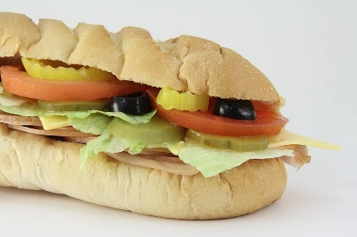
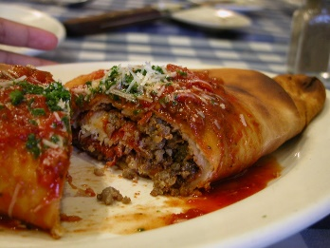
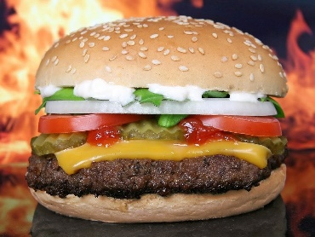
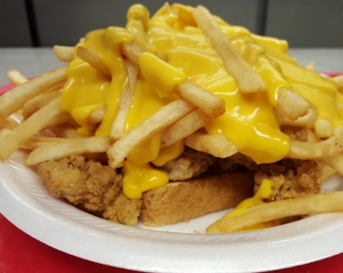
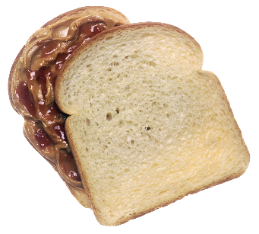
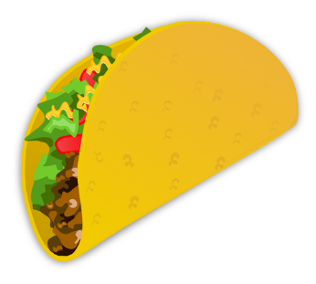
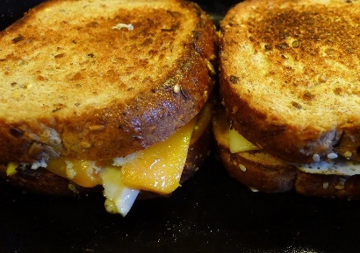
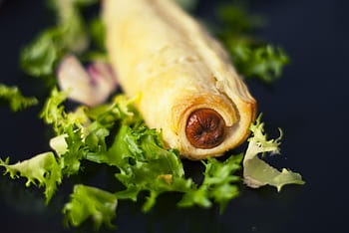
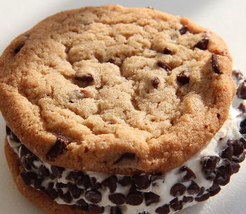
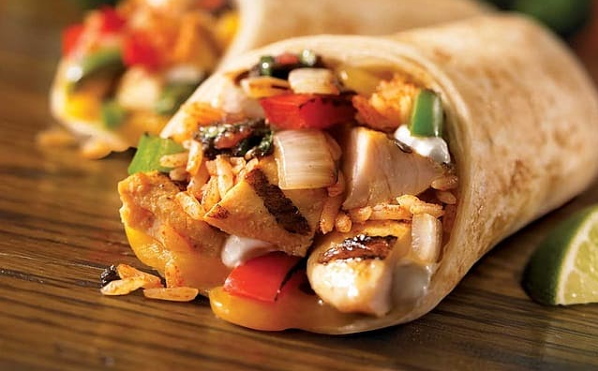
Do you agree with this classification?
Sandwiches | Not Sandwiches
Is there one correct answer?
Notes:
NOTE: Ask students to share how many items they classified as sandwiches? The numbers are range from only a few to most of them! The classification shown is just an example and should not be considered as the only correct response.

Slide 11
As we saw in the video, there are different families of spiders based on their physical characteristics, anatomy, behaviors, etc.
Are there different types of “sandwiches”?
Group Discussion
If so, what “families” of sandwiches could we have?
How would we describe each family; i.e. what characteristics would each have?
Let’s give it a try …
Notes:
Note: This slide is NOT included in the digital version of student INB. It is used to facilitate a class discussion prompting students to brainstorm ways to classify sandwiches.

Slide 12
Part C: Final Challenge
Directions:
Classify the items listed into 5 categories.
Each item can be used only once, but you can add other sandwiches not listed.
Each section must have at least one item.
Label each “layer” with the characteristics you used to classify those items together.
Sandwich Checklist
Subway Sub
Taco
Pig in a Blanket
PB&J
Poptart
Chicken strip horseshoe
Corn Dog
Hamburger
Meat & cheese on crackers
Grilled cheese
Burrito
Sausage McGriddle
Calzones
Hot pocket
Ice cream sandwich
You may add other “sandwiches” to your chart!

Slide 13
Part D: Wrapping It Up
How does classifying sandwiches relate to the video you watched about classifying spiders? List at least three things.
Notes:
Use this slide to facilitate a class discussion after students have had a chance to respond in their notebooks.
Some possible answers are:
We asked questions.
We made observations.
We communicated our ideas and got feedback from our peers.
We changed our ideas or opinions based on a definition we all agreed upon.
We used our past observations and knowledge to make new hypothesis (i.e. whether something was a sandwich)
We worked together (collaborated)
We based our decisions on specific information (bun/no bun, meat/no meat) and not random opinions.
We defined a problem in terms that we were sure we all discussed the same things.

Slide 14
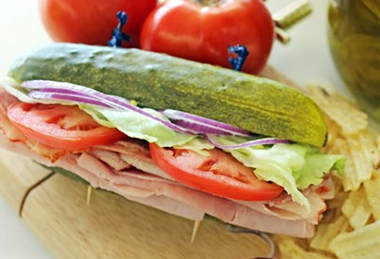
Is this a sandwich based on our definition?
Scientific Definition - A sandwich is a food consisting of 1 or more pieces of bread (or other pastry) with a filling.
It would not be a sandwich based on the “scientific definition” – no bread.
Notes:
Note: This final slide is NOT included in the digital version of student INB. It will spark quite a discussion! I like to compare it to the work scientists do – just when we think we have something figured out, along comes a new observation/occurrence that sends us back to the drawing board.

