Slide 1
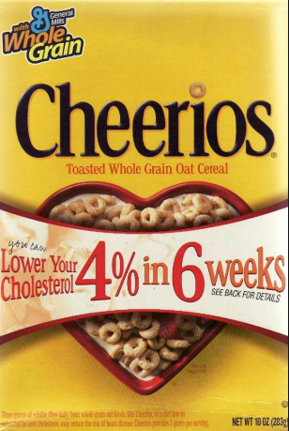
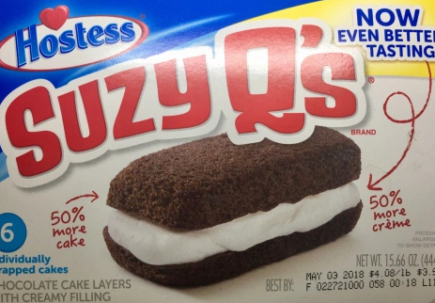
Consumer’s Challenge
Are the claims true?
Presentation by T. Tomm 2019 sciencespot.net

Slide 2
Part A: Mass Challenge
1) Estimate the mass for each item in grams. After you have written down ALL the estimates, use a triple-beam balance or electronic scale to find the mass of each item.
2) How close were your estimates to the actual masses? Explain.

Slide 3
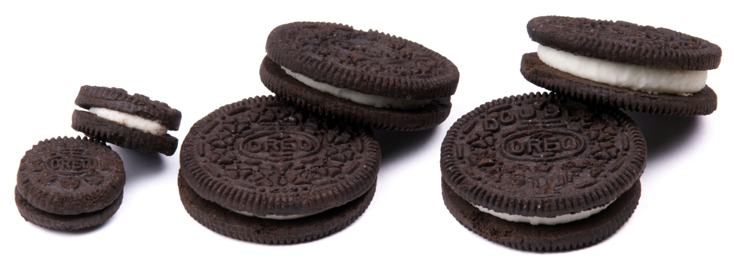
Are “double-stuffed” really double the stuffing?
Many companies advertise their products with claims they are the best value, are better tasting, or have a longer lasting flavor.
Sometimes the name of the product implies it more filling, such as the double-stuff variety of Oreos.
Are these claims true?
This Photo by Unknown Author is licensed under CC BY-SA

Slide 4
Before we begin …
How will we measure the filling – volume or mass?
How many times should we collect data, i.e. how many cookies need to be sampled?
How will we make sure our results are accurate and reliable?
Would it be better to do one cookie or a whole package of cookies? Why?
We will have to measure carefully making sure all the filling is scraped off when needed.
We will record our data as it is collected.
By collecting data on many cookies instead of one, we can get an average to use for comparison.

Slide 5
Part B: Make A Prediction
Is a double-stuff Oreo really double the stuff?
Write a prediction based on your knowledge of regular and double-stuff Oreos.
I predict the double-stuffed Oreos will have _________ filling, because _______________________________ ____________________________________________ ___________________________________________.
Half, double, triple, other?
What are your observations? What do you already know about Oreos?

Slide 6
What safety rules do we need to follow?
For safety, all food items must be placed on a coffee filter or piece of paper towel instead of set directly on the scale.
Hands must be washed before beginning testing.
No Oreos used for testing should be eaten without your teacher’s permission.
Any Oreos that may not be safe will be collected by your teacher.
No horseplay or messing around during the lab or the teacher will eat your Oreos or give them to someone else to enjoy!

Slide 7
Testing Procedure
Materials: 1 regular Oreo, 1 double-stuffed Oreo, 1 popsicle stick, 2 pieces of wax paper, 1 paper towel, and a scale.
Take apart the regular cookie.
Use the popsicle stick to scrape the filling off both cookie parts and place on your piece of wax paper.
Find the mass of the filling. Record in your chart.
Repeat steps 1-3 for the double-stuffed Oreo.
Use your data to calculate the ratio of double-stuff filling to regular filling. Be prepared to share your results.

Slide 8
2) Follow your teacher’s directions to complete the tests. Record your data in the chart below.
Type of Cookie | Mass of filling (g)
Regular
Double
3. Calculate the ratio of the mass of the double-stuffed filling to mass of the regular filling.
___________________ ÷ ________________ = __________________
Mass of Double Mass of Regular Ratio of Double to
Filling Filling Regular (Decimal)

Slide 9
Share your results: Mark your ratio on the scale below. List your ratio along with your initials.
1.00
2.00
3.00
What does the data tell us?
Notes:
I use a Google form to collect the results from each person, which can be displayed as a spreadsheet on the classroom computer.

Slide 10
4) Analyze the classroom data chart provided by your teacher. What were the overall results? Explain using the classroom data and your own observations.
5) Was your prediction correct? Explain why or why not.
6) Would you consider the classroom data accurate and reliable? Why or why not?

Slide 11
Bonus Activity: Mega Challenge
We are going to repeat the experiment with Mega Stuffed & Chocolate Cream Oreos.
1st - Make a prediction of how the mass of the mega stuff filling will compare to regular AND double stuff filling.
2nd – Follow the same procedure to find the mass of the filling for each cookie.
3rd – Record data and use it calculate the ratio for both.
___________________ ÷ ________________ = __________________
Mass of Mega Mass of Regular Ratio of Mega to Regular
___________________ ÷ ________________ = __________________
Mass of Chocolate Mass of Regular Ratio of Choco to Reg
What does the data tell you? Was your prediction correct? How do the results compare with the regular and double?

Slide 12
Just for fun … How are they made?
How many type of cocoa are used? Why?
What type of oil is used?
Why do they add dry ice?
How many wafers can be made in an hour?
How long are they baked?
How do they get them into the right position for filling?
How many cookies are in a tray of regular cookies?

Slide 13
What questions do you have about Oreos?
Write ONE question on the front of a post-it note & give to your teacher.
Questions?
Research your question and write the answer on the back of the post-it note.
Return to the teacher.
Answers?

Slide 14
Part C: Variables & C0ntrols
What was wrong with the first experiment?
What is a controlled experiment?
What variables were constant or kept the same?
Identify the independent and dependent variables.
Why is it important to conduct controlled experiments?
This Photo by Unknown Author is licensed under CC BY

Slide 15
The answers are …
What was wrong with their first experiment?
What is a controlled experiment?
What variables were constant or the same?
They did not keep everything the same – different locations, different amounts of water.
In a controlled experiment, all the variables that could affect the outcome are kept the same except for one.
Same sized pot, same type of soil, same amount of soil, same temperature, and same amount of sunlight.

Slide 16
Identify the independent and dependent variables.
Why is it important to conduct controlled experiments?
Independent = Amount of water (what we do)
Dependent = Height of plant (what we measure)
Our results will be more reliable, and we will be able to identify how one variable influences the outcome.

Slide 17
Part D: Your Turn
Identify an advertising claim that could be tested using a controlled experiment in the classroom to determine if the claim is true or not.
Must be safe to do in the classroom.
Must be completed in one class period.
Must follow proper safety procedures.
Your experiment will need to be approved by the teacher before you can complete it.
Create a Google document that answers all the questions listed on the next slide and submit it to your teacher for approval.

Slide 18
Create a Google document that answers all the questions below and submit it to your teacher for approval.
Make a prediction of the outcome of your experiment.
Identify the controls, independent variable, and dependent variable.
What materials will you need? Make a list of all the items you’ll need. Your teacher may be able to help with providing some of the items.
What data will you collect? How will you collect it?
How will you perform the experiment? List the steps with as much detail as possible so someone else could conduct your experiment the exact same way you will.
What will you do to make sure the results are accurate and reliable? For example, will you test more than one sample? What will you do to measure accurately?
What safety rules will you need to follow? List all of them.

Slide 19
Be prepared to conduct your experiments on ___________.
All materials will need to be collected and in the classroom by ______________.
After conducting your experiments, your team will write up the results and present them to the class for peer review.

