Slide 1
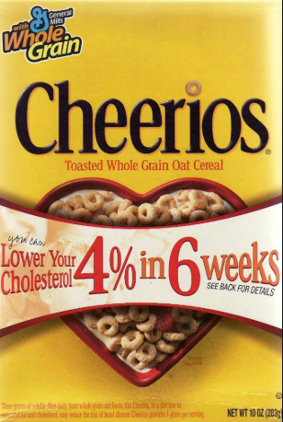
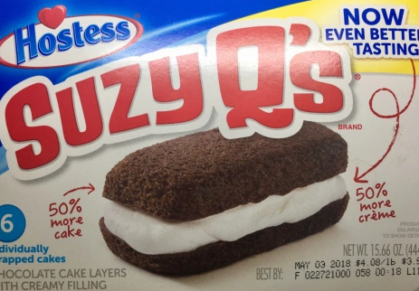
Digital Notebook for Students
https://docs.google.com/presentation/d/1AMVEzT5n-iQ2L9XbHKroxQwA-o3yiOffpSBlA_dw4IQ/edit?usp=sharing
Consumer’s Challenge
Are the claims true?
Presentation by T. Tomm 2019 sciencespot.net

Slide 2
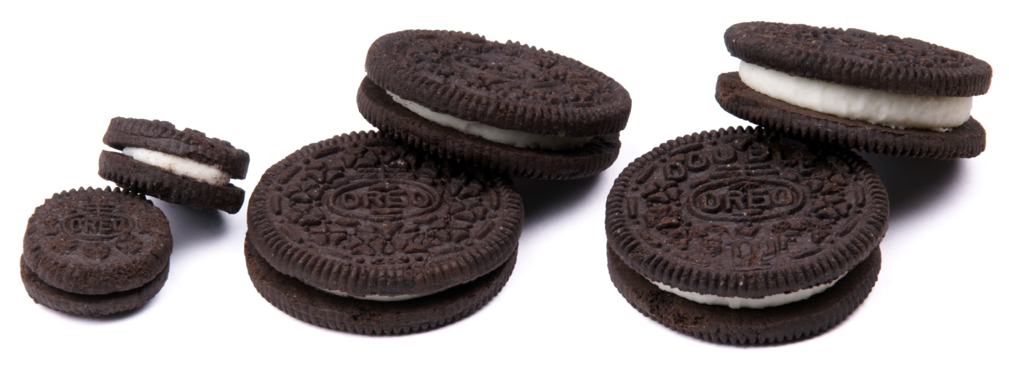
Are “double-stuffed” really double the stuffing?
Many companies advertise their products with claims they are the best value, are better tasting, or have a longer lasting flavor.
Sometimes the name of the product implies it more filling, such as the double-stuff variety of Oreos.
Are these claims true?
This Photo by Unknown Author is licensed under CC BY-SA

Slide 3
Part A: Make A Prediction
Is a double-stuff Oreo really double the stuff?
Write a prediction based on your knowledge of regular and double-stuff Oreos.
I predict the double-stuffed Oreos will have _________ filling, because _______________________________ ____________________________________________ ___________________________________________.
Half, double, triple, other?
What are your observations? What do you already know about oreos?

Slide 4
Before we begin …
How will we measure the filling – volume or mass?
How many times should we collect data, i.e. how many cookies need to be sampled?
How will we make sure our results are accurate and reliable?
Would it be better to do one cookie or a whole package of cookies? Why?
We will have to measure carefully making sure all the filling is scraped off when needed.
We will record our data as it is collected.
Collect data on many cookies instead of one and use the average to compare them.

Slide 5
What safety rules do we need to follow?
For safety, all cookies must be placed on a piece of paper towel set directly on the scale.
Hands must be washed before beginning testing and after you finish.
No Oreos used for testing should be eaten without your teacher’s permission.
Any Oreos that may not be safe will be collected by your teacher.
No horseplay or messing around during the lab!

Slide 6
Testing Procedure
Materials: 1 regular Oreo, 1 double-stuffed Oreo, 1 popsicle stick or spoon, small plastic cup, and a scale.
Directions:
1st - You will need to measure the mass of the cookie with the filling. Record in your chart.
2nd - Take apart the cookie and use the stick/spoon to scrape the filling off both cookie parts. Place the filling in a plastic cup. Find the mass of the cookie parts. Record in your chart.
3rd - Subtract the mass of the cookie parts from total mass of the cookie with filling. Record in your chart for the mass of the filling.
4th - Repeat steps 1-3 for the double-stuffed Oreo.
5th - Calculate your ratio – see the formula under the chart. Be prepared to share your results.

Slide 7
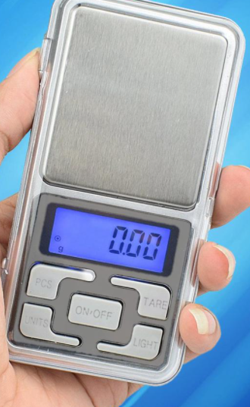
Using an electronic scale …
Make sure the metal pan is clean.
Click ON-OFF to turn it on.
Click LIGHT to turn it off to save battery.
Push TARE to zero the scale.
Place the plastic cup on the scale.
Press TARE again to adjust for the cup.
NOTE: Now we can add the things we are measuring to the cup and not have to calculate the mass.

Slide 8
Part B: Testing Results
Use your results to calculate the ratio of the mass of the double-stuffed filling to mass of the regular filling.
Type of Cookie | Mass A- Cookie with filling(g) | Mass B - Cookie without filling (g) | Mass of filling (g) (Subtract → A-B)
Regular
Double
To determine the ratio, divide the mass of the double-stuffed filling by the mass of the regular filling. Express as a decimal to the nearest hundredth.
___________________ ÷ ________________ = __________________
Mass of Double Mass of Regular Round to 2 decimal
places

Slide 9
Share your results: Mark your results on the scale below along with your initials.
1.00
2.00
3.00
What does the data tell us?
Notes:
I use a Google form to collect the results from each person, which can be displayed as a spreadsheet on the classroom computer.

Slide 10
Part C: Discussion Questions
1. Analyze the classroom data chart provided by your teacher. What were the overall results? Explain using the classroom data and your own observations.
2. Was your prediction correct? Explain why or why not.
3. Would you consider the classroom data accurate and reliable? Why or why not?

Slide 11
Part D: Going Further - How are they made?
How many type of cocoa are used? Why?
What type of oil is used?
Why do they add dry ice?
How many wafers can be made in an hour?
How long are they baked?
How do they get them into the right position for filling?
How many cookies are in a tray of regular cookies?

Slide 12
What other questions do you have?
Some ideas to research:
Process from start to finish → How long? How many cookies made in one batch?
# of cookies made per day
Bake time/temperature for different brands
How many flavors have been made?
Records – most sold, # stacked, most eaten, etc.
National Oreo Day? First Oreo made?
Interesting facts about Oreos - # of ridges, amount of filling, diameter of cookie

Slide 13
Chocolate Stuffed vs. Regular
OPTIONAL: This slide is NOT included in the student assignment.
You will need two other types of Oreos – mega stuffed, special flavors, etc. to test. Follow the same procedures as the original tests to see if you can find a different.
Type of Cookie | Mass A- Cookie with filling(g) | Mass B - Cookie without filling (g) | Mass of filling (g) (Subtract → A-B)
Chocolate
_________________ ÷ ____________________ = _______________
Mass of Chocolate Filling Mass of Regular Filling
← How does this compare to your other tests?
Mega Stuffed vs. Regular
Type of Cookie | Mass A- Cookie with filling(g) | Mass B - Cookie without filling (g) | Mass of filling (g) (Subtract → A-B)
Mega
← How does this compare to your other tests?
_________________ ÷ ____________________ = _______________
Mass of Chocolate Filling Mass of Regular Filling

Slide 14
Part E: Controlled Experiments
What is a controlled experiment?
What variables were constant or the same?
What variable was tested?
Identify the independent and dependent variables.
Why is it important to conduct controlled experiments?
All variables EXCEPT the ones you are testing are controlled
Same pot, soil, plant, same amount of sunlight
Amount of water
Amount of water
Size of the plant
Quality control, accurate/reliable results, testing the correct thing

Slide 15
Your turn: Consumer’s Challenge
Identify an advertising claim that could be tested using a controlled experiment in the classroom to determine if the claim is true or not. Your experiment will need to be approved by the teacher before you can complete it.
Must be safe to do in the classroom.
Must be completed in one class period.
Must follow proper safety procedures.
Time to plan your experiments!
Be prepared to conduct your experiments on ___________.
All materials will need to be collected and in the classroom by ______________.
After conducting your experiments, your team will write up the results and present them to the class for peer review.

Slide 16
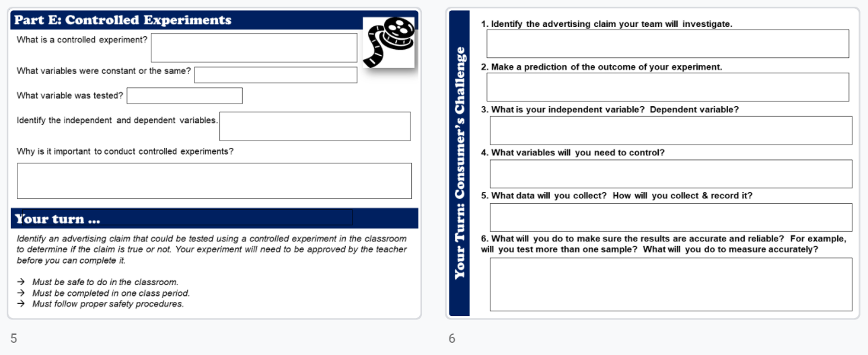
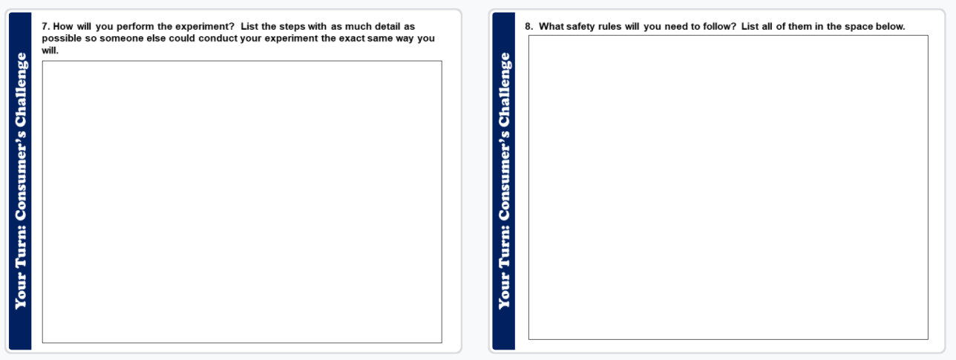
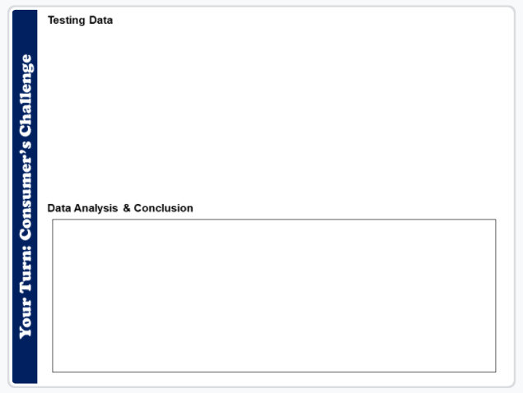
Your turn: Consumer’s Challenge
Complete slides 6-9 to test your own consumer claims!

