Slide 1
Materials Needed:
Four different types of bubble solutions (Dollar store bubble solution, generic liquid hand soap, Dawn dish soap, & Wowmazing (available from Amazon)
Glycerin or sugar (optional)
Small plastic cups
Drinking straws
Safety goggles
Smooth table surface (or laminated cardboard sheets)
Rulers (metric)
Paper towels for cleanup
Student Resources
Student Digital Notebook –Google Slides https://docs.google.com/presentation/d/1iaJeGXzx9cbsE0iA3DiTx7LHjFrj3PCZ5lms7XDp9AE/edit?usp=sharing
Student worksheet – PDF version available at https://sciencespot.net/Media/STEAM/STEAMMini_BubbleScienceWkst.pdf
It’s time for …
Bubble Science
Scientific Investigations & Data Analysis
Presentation by T. Tomm 2020 Updated 2022 sciencespot.net
8th Grade Science

Slide 2
Measurement Review
1 centimeter = 10 millimeters
½ centimeter = 5 millimeters
1/10 cm = 1 millimeter
Nearest cm
Tenth of a cm
68
67.9
15
14.5
46
46.3
Making accurate measurements during a lab requires you to be able to measure with a metric ruler. Always make sure the zero end of the ruler is in the correct location. Double check your measurements before you record them in your data chart.
Source: https://www.brownsburg.k12.in.us/cms/lib/IN02200676/Centricity/Domain/1135/7thGrade-%20GTT%20-%20Day1.pdf

Slide 3
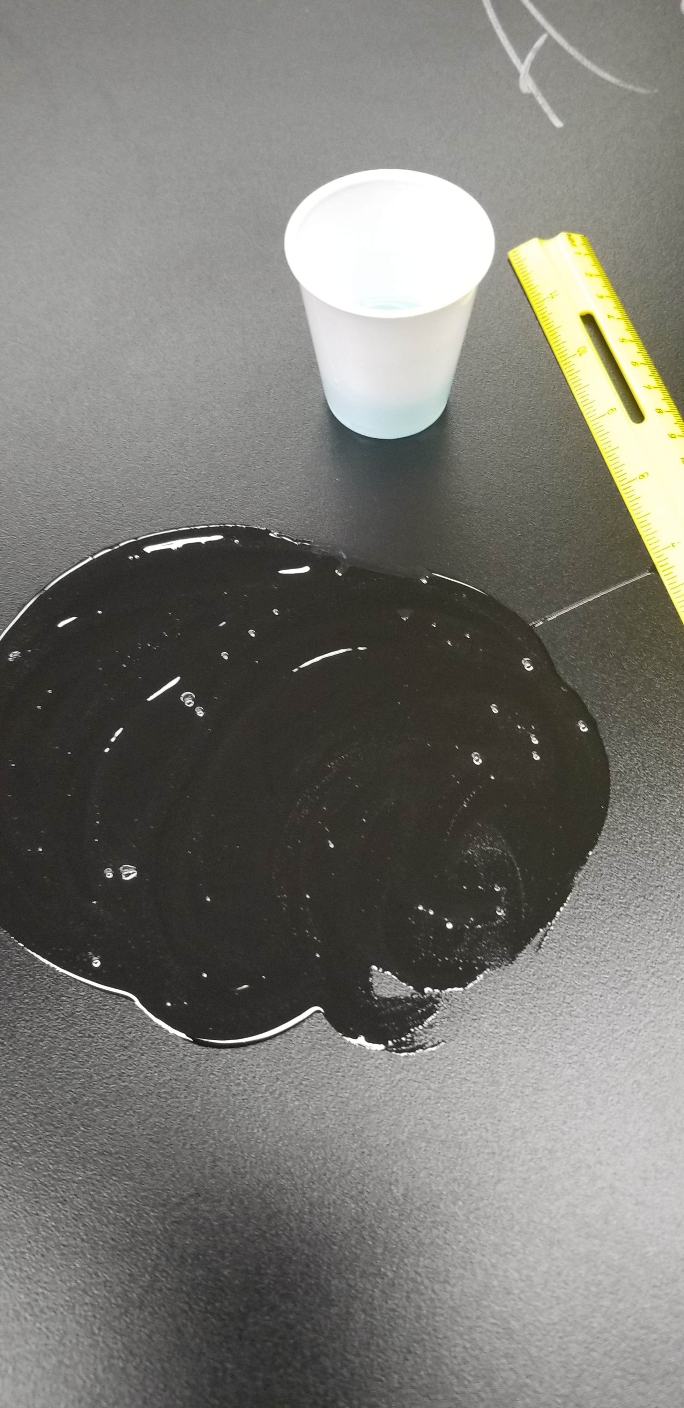
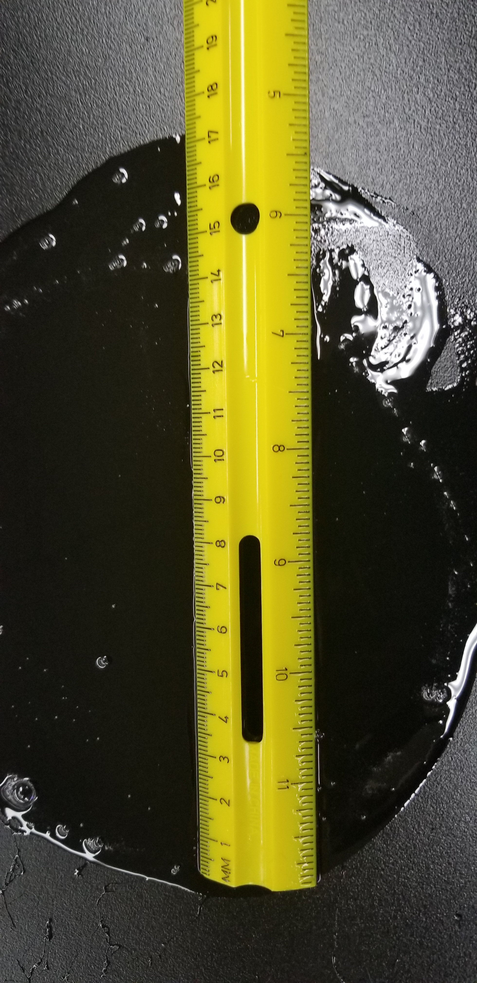
Lab Directions
Use your hand to spread a small amount of the solution into a large circle on the table directly in front of you.
Dip a straw directly into the solution cup and then place it near the bubble solution on the lab table.
Begin SLOWLY lowing a bubble on the surface of the table. Continue blowing until it “pops.”
4) Measure the diameter of the ring remaining on the surface of the table at the widest point to the nearest tenth of a centimeter. Record this diameter in your data table.
5) Repeat steps 2-4 until you have data for 10 bubbles. You may need to add additional bubble solution to your smear on the table.

Slide 4
SAFETY RULES
You must wear SAFETY GOGGLES! Bubbles will pop and may splatter.
Do not touch your face or eyes after handling the bubble solution. If any gets in your eyes, tell the teacher immediately.
Only use the straws to blow bubbles – do not try to drink the bubble solution, tip it upside down while in your mouth, or use it to “spit” bubbles at another student.
Clean up at the end of class, which includes cleaning up your table, washing your hands and putting the goggles in the UV cabinet.
COVID-19 Procedure – Keep your mask on if its required! You can blow bubbles through your mask.

Slide 5
Part A: Experiment
Read the lab directions AND the safety rules BEFORE you begin.
Use the chart to record the diameter of your bubbles (nearest tenth of a centimeter).
Also record any observations you make that might help you explain your data/results.
Trial # | Bubble Diameter
1
2
3
4
5
6
7
8
9
10
Average =
Observations
How would you describe the bubble solution?
What did you do to get better bubbles? Explain
What things caused smaller bubbles? Explain.
Suggestions include its color, thickness, odor, strength (pops easily or takes a lot to pop), etc.
Use easy, slow breathes
Use a good-sized smear on the table that isn’t too foamy
Blowing straight down from the top
Using fast, strong breathes
Blowing from the side/edge of the bubble causes it to move away from you
Not getting enough solution on the end of your straw before blowing a bubble
Add up all 10 #s, hit equals, divide by 10
(Is your average between your smallest and largest bubble? If not, recalculate it!)

Slide 6
Part B: Analysis
1. Summarize your data from the lab. Compare your results to those of your tablemates.
2. What are three possible sources of error? Explain.
Examples: My smallest bubble diameter was ______ cm and the largest was _____ cm.
My average was higher than/lower than __________.
My average was the highest/lowest in the class.
Use your average on Slide 2 for comparisons!
Measured wrong/inaccurate
Calculation mistakes
Entered wrong data in chart

Slide 7
Part C: Bubble Basics
What is a bubble? Click to watch the video →
Are there different types of bubbles? Explain.
What materials would make the BEST bubbles?
What are the current world records for bubbles? Include your source so you can share your information with the class.
Two layers of soap with water in between around a central pocket of air
Possible answers include - Different sizes, different tint/colors, different materials (soap, gum, milk, spit)
Answers will vary – try to create a list of the top 3 substances you would like to test
Answers will vary – try to find records for largest bubble, longest-lasting, concentric bubbles, most bubbles blown in a minute, or any other bubble-related records

Slide 8
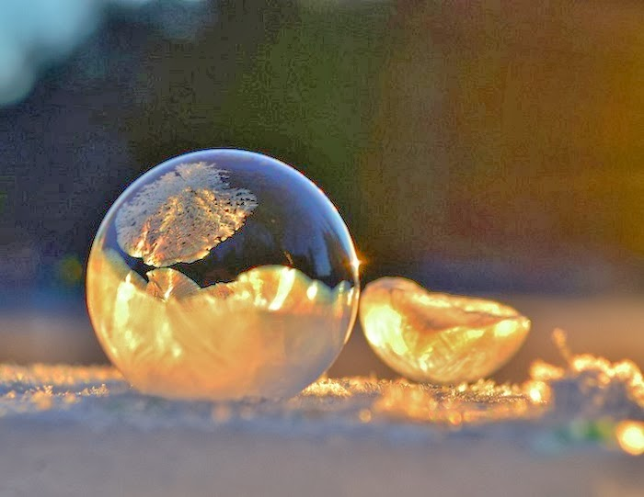
Explore More: Bubble Tricks
Visit these links to explore more …
Bubble Art
https://www.youtube.com/watch?v=FZpftZccc6U
Bubble Hacks
https://www.youtube.com/watch?v=0QmWQz9kn84
Bouncing Bubbles
https://www.youtube.com/watch?v=2TbiJxhPp_4
Concentric Bubbles
https://www.youtube.com/watch?v=OntX1115Tw4
Concentric Bubble Record
https://www.youtube.com/watch?v=dPVe5OV08Fc
Note: This slide is not included in the student HDSN.
Find a good bubble-related video or image? Share it with your teacher!
This Photo by Unknown Author is licensed under CC BY

Slide 9
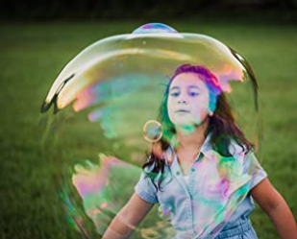
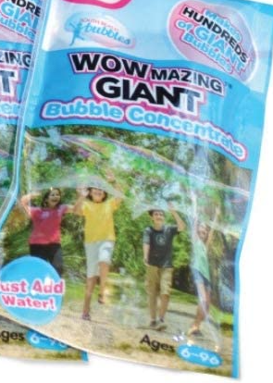
Part D: Giant Bubble Challenge
Challenge Question: Which bubble solution creates bigger bubbles?
Refer to the list of the “best materials” students created in Part C to determine the three you will test.
Wowmazing is available from Amazon or Walmart.
NOTE: You can also add sugar or glycerin to any of the soap solutions to give them some extra “power”.
Brand → | Generic Hand Soap | Dawn Dish Soap | Wowmazing
1
2
3
4
5
6
7
8
9
10
Average
Observations
Follow the same directions and safety rules for all tests!

Slide 10
Part D: Analysis
Which brand had the highest overall average? ___________________
Which brand had the highest overall average for the class? ____________
Answer the challenge question by summarizing your data and observations from all the labs.
Are your results accurate and reliable? Explain.
Which brand was the best for you?  Which was best for most people? 
Question: Which bubble solution creates bigger bubbles?
Use your data and other data from your classmates to rank the three solutions you tested. What observations did you make that might be important factors in your decision?
Did you measure correctly each time?
Did you read the ruler correctly?
Did you measure the correct spot/distance for each bubble?
Did you enter the wrong measurement in the chart by mistake?
What other errors might you or your classmates have made?

Slide 11
Take It Further: Your Turn
What variables could we investigate related to this lab? Create at least 5 questions we could test using the resources we have available.
Possible variables include
Other liquids (laundry soap, shampoo, etc.)
Temperature of the bubble solution (cold vs. hot)
Air temperature (warm vs. freezing)
Viscosity of the bubble solution (thin vs. thick)
Varying amounts of glycerin/sugar affects bubble size or lasting time
Different surfaces (waxed paper, foil, plastic wrap, concrete, tile, etc.)
Types of blowing apparatus (wand vs. straw, different diameter straws)

Slide 12
Use this slide to record your data.
Use this slide to write your analysis and conclusion.
BE PREPARED TO SHARE YOUR RESULTS WITH YOUR CLASSMATES.

