Slide 1
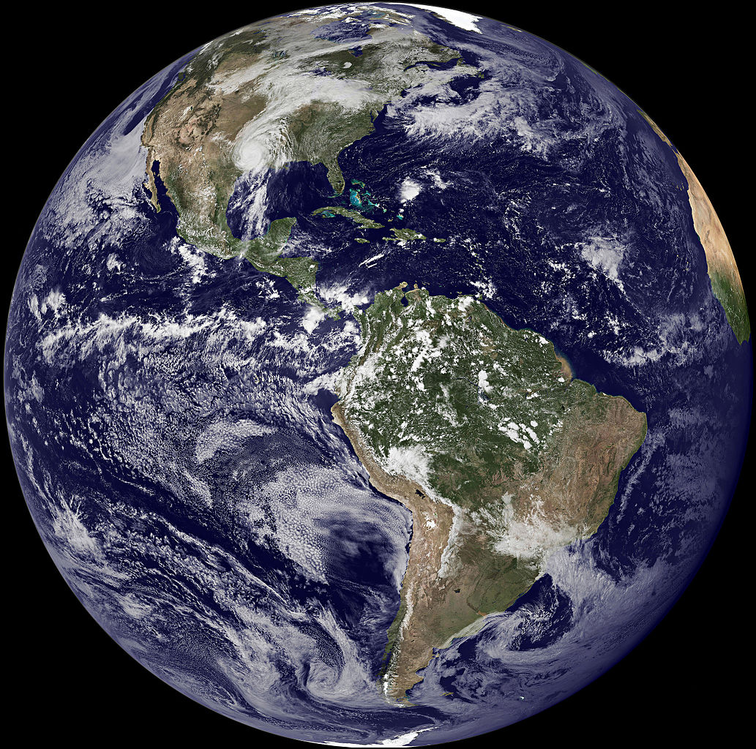
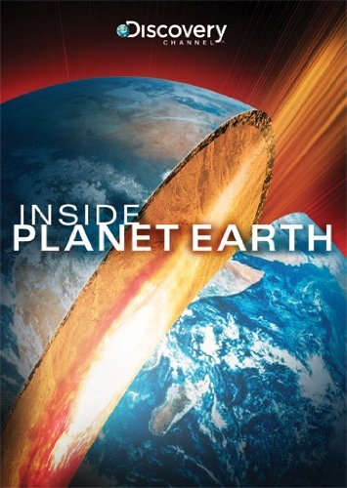
Inside Planet Earth: Surface to Center
The Inside Planet Earth DVD is available from Amazon. It is also available online at http://documentaries-plus.blogspot.com/2012/06/inside-planet-earth-discovery-channel.html
Student Digital Notebook available at https://docs.google.com/presentation/d/1TIAV74UX41mbfioSfhTjs4-2ITheJXvQJO9L4alELuw/edit?usp=sharing
NOTE: You will need to make a copy of the slides to assign to your students.
← Teachers: See notes to the left of the slide.
Section 1
Section 2
Section 3
Section 4
Section 5
T. Tomm Updated 2022 https://sciencespot.net/

Slide 2
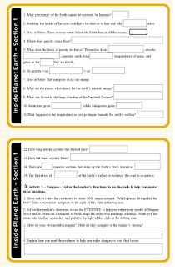
Go to Google Classroom and open the HDSN for this unit.
Answer the questions on slides 1 & 2 as you watch the video.
We will review the answers so you can fix any you miss!
We will do the activity together in class.
Section 1 Video Segment 0:00 – 16:38
Section 1 Activity
http://documentaries-plus.blogspot.com/2012/06/inside-planet-earth-discovery-channel.html

Slide 3
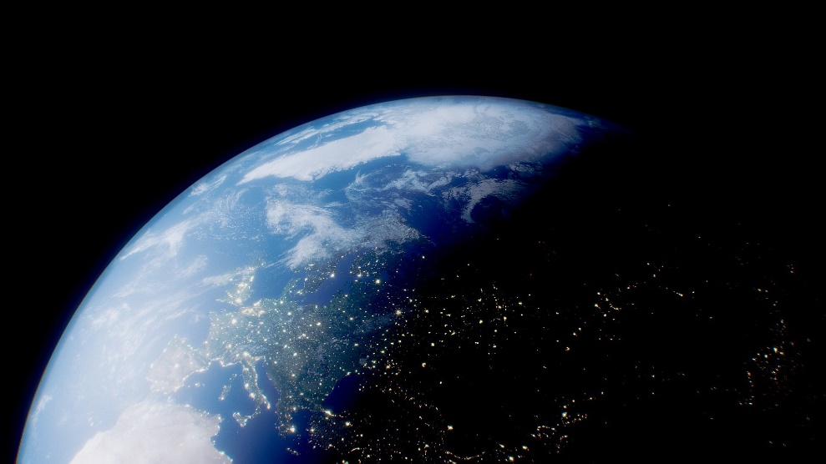
Section 1: Introduction
What percentage of the Earth cannot be accessed by humans? 99%
Studying the inside of the core could give us clues as to how and why life exists.
3. True or False: There is more water below the Earth than in all the oceans.
This Photo by Unknown Author is licensed under CC BY

Slide 4
4. Where does gravity come from? Earth’s dense core
5. What does the force of gravity do for us? Protection from meteorites, absorbs radiation, insulates earth from freezing temperatures of space, and gives us the air that we breath.
6. No gravity = no atmosphere = no life.
7. True or False: The sun gives us all our energy.
8. What are the pieces of evidence for the earth’s internal energy? Volcanoes, mountains, caves

Slide 5
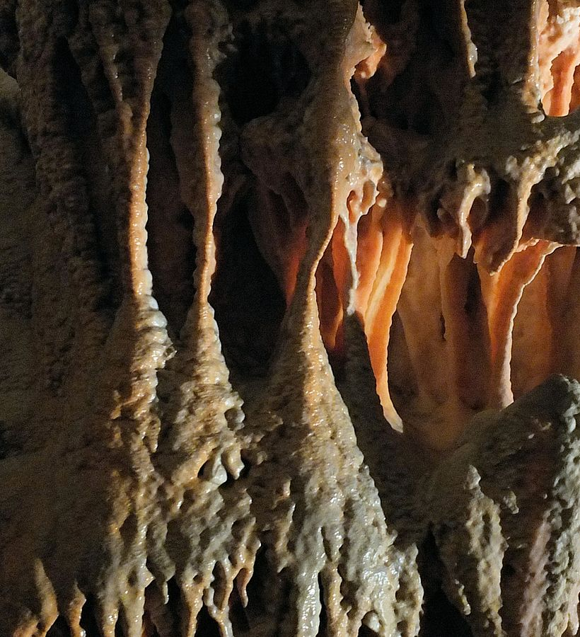
9. What can fit inside the large chamber of the Carlsbad Caverns? A jumbo jet
10. Stalactites grow downward, while stalagmites grow upward. “hold tight to the top” “might reach the top”
11. What happens to the temperature as you go deeper beneath the earth’s surface? Increases (and so does pressure)
Explore it …
Virtual Tour – Carlsbad Caverns
This Photo by Unknown Author is licensed under CC BY-SA

Slide 6
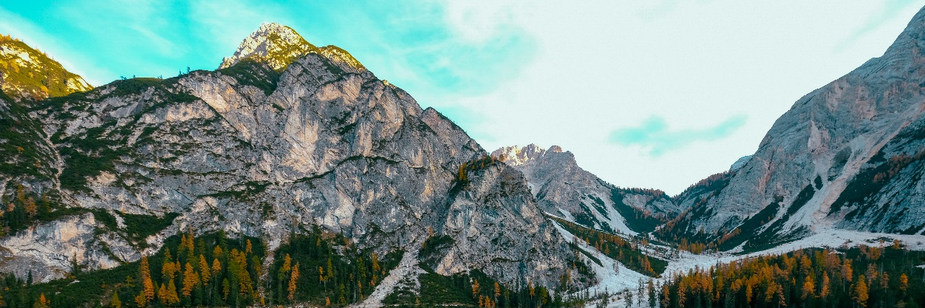
12. How long are the crystals that formed here? 40 feet long
13. How did these crystals form? The crystals grew in mineral-rich water in an underground lake that was boiled by magma.
14. There are seven massive sections that make up the Earth’s crust. These sections are known as plates.
How many plates are there in total – major and minor?
7 major + 8 minor = 15 plates
15. The formation of mountains at the Earth’s surface is evidence the crust is in motion.

Slide 7
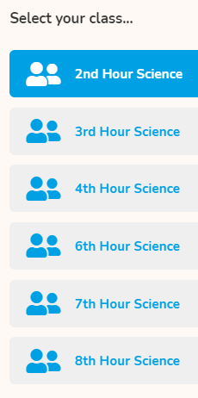
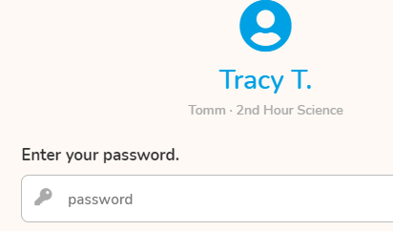
Gizmos - Pangaea
Go to mrstomm.com → Click the Gizmos logo on the homepage. Follow these directions to login.
Click your name
Click the G
mrstomm
Use mrstomm as the username
Select your class
Click BUILDING PANGAEA
126S12345
Use your 126S#

Slide 8
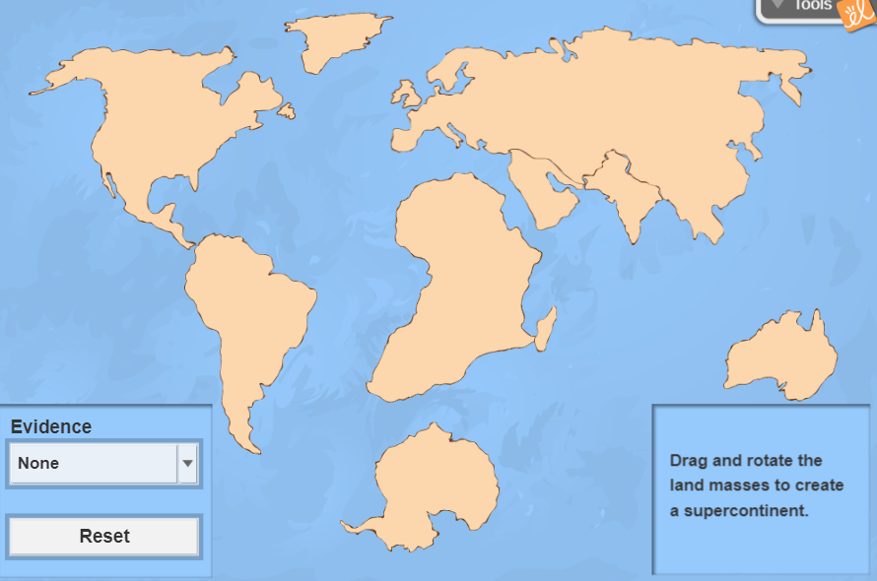
Background Information:
In 1915, a German scientist named Alfred Wegener (VAY-guh-ner) proposed the theory of continental drift.
According to this theory, the landmasses once were joined into a supercontinent called Pangaea. The landmasses then slowly drifted to their current positions.
Scientists have gathered evidence from fossils, rocks, and glaciers to help them piece together the puzzle of the past.
Can you get all the continents to fit together as one large supercontinent?
?

Slide 9
Directions:
Move the cursor over a continent. You should see the hand cursor when you are over the middle. Click-and-drag to move the continent.
You should see the circle arrow when you are near an edge. Click-and-drag to rotate it.
MY PANGAEA SCREENSHOT Paste your final version over this image.
?
Can you get all the continents to fit together as one large supercontinent?
Use the evidence to help you. Pull down the menu to see the options.
The colored bands represent the evidence that scientists used to piece together the puzzle of the past.
Continue working on your “puzzle” to get all the evidence to line up.
Start with the fossils and then use the rocks and glaciers.

Slide 10
Assignment:
Finish your map and paste the screenshot to the right of your slide.
Answer the questions UNDER THE GIZMOS and #2 ON SLIDE 2.
https://www.cnn.com/2020/08/30/us/map-hometown-earth-continental-drift-scn-trnd/index.html https://dinosaurpictures.org/ancient-earth#120

Slide 11
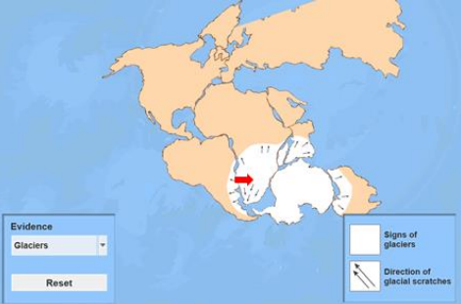
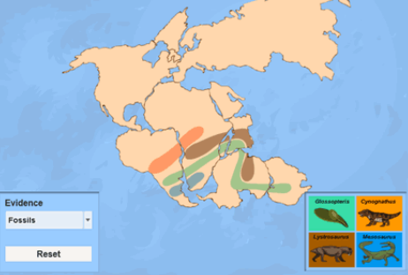
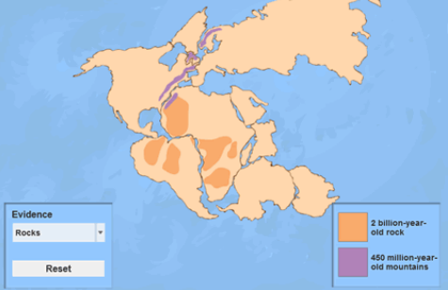
Answer the questions by comparing your screenshot with these.
From 1 to 10, what would you rate your efforts?
1. How does your screenshot compare to the teacher’s version?
2. How did the evidence help you complete the puzzle? Explain.

Slide 12
Section 2
Section 2 Video Segment 16:38 -40:36
Section 2 Activity
http://documentaries-plus.blogspot.com/2012/06/inside-planet-earth-discovery-channel.html

Slide 13
Coal is the fossilized remains of a super forest.
How did the giant forests affect the atmosphere? Used up CO₂ in photosynthesis to create oxygen.
What role did energy from inner Earth play in the formation of Pangaea? It reshaped the landmasses
Temperatures in the mines are 130 degrees Fahrenheit.
Why are bacteria deep in the earth’s crust interesting to scientists? They have been undisturbed for eons, which could help explain the origins of life.
What was the deepest hole ever drilled? 7.5 miles

Slide 14
7. What built the stromatolites? Bacteria
8. How did oxygen help turn the seas blue? The oxygen bonded with iron in water, which floated to the bottom and turned the seas blue.
9. There is 20 times more oxygen trapped in iron ore than floating in the atmosphere.
10. What did they compare the consistency of mantle rock to? Fudge
11. If the mantle was unable to flow, there would be no plate movement, no major ocean basins, and no mountain ranges.
12. The pressure in the mantle is 50,000 times greater than what we feel at the surface.

Slide 15
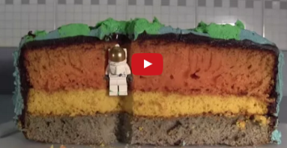
Your assignment …
Layers of the Earth
Go to Google Classroom to find the EDPuzzle Layers of the Earth assignment.
Fill in the slide as you watch the video.
The video quiz WILL COUNT AS A GRADE!
Done? Start working on the new Legends playlist.

Slide 16
Activity A: Layers of the Earth
Check your answers IF YOU ARE DONE!
CRUST
5
25
__________ - Thinnest layer ranging from _____ mi under the oceans to_____ mi
under continents.
How many miles to go from the crust to the core?
4000 mi
MANTLE
1800
____________ - Largest layer at ________ mi thick; the upper layer that includes the crust is called the ______________, which floats on top of a plastic-like layer called the ____________________; temps range from ______- _____ºF.
LITHOSPHERE
ASTHENOSPHERE
1600 -7900
What type of heat transfer in a fluid causes warmer portions to rise and the colder portions to sink?
Convection currents → Magma moves in the asthenosphere
→ Moves the plates like a conveyor belt

Slide 17
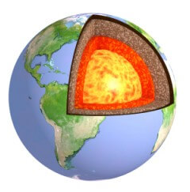
OUTER CORE
_______ _______ - 1400 mi thick liquid layer made mostly of _______; temps range from _____________º F; the movement creates a _____________ field.
IRON
7900-11000
MAGNETIC
INNER CORE
780
IRON
_____ _______ - Solid layer that is _______ mi thick; made of ________ and ____________ with temps up to ________ºF, but kept solid due to very high ____________.
NICKEL
13,000
PRESSURE

Slide 18
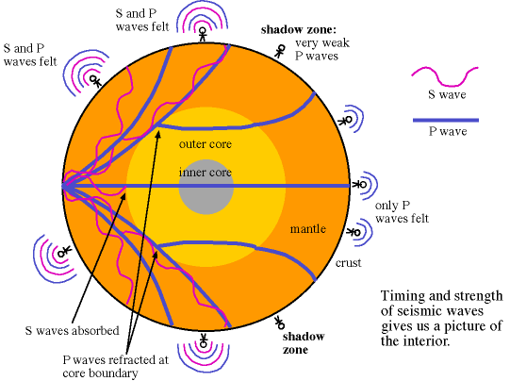
Layers of the Earth Think About It
A) If we cannot see the center of the Earth, how do we know about it? List two ways we have learned about the core.
B) What other items could be used as a model for the Earth's structure? Explain how it would show all the layers of earth in the diagram above.
SEISMIC WAVES gives us clues about earth’s interior
→ Analyze VOLCANIC ROCKS brought to the surface by volcanoes & other tectonic activity
https://www.astronomynotes.com/solarsys/s8.htm

Slide 19
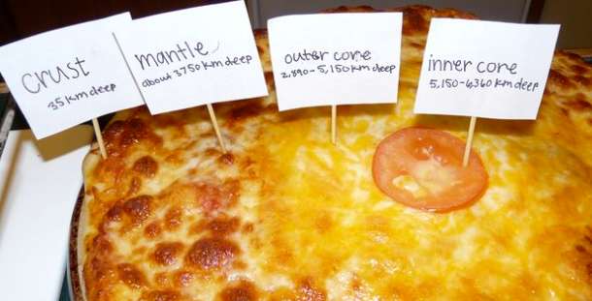
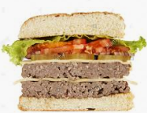
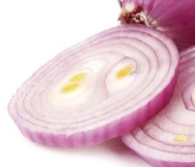
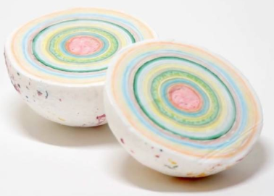
Examples …

Slide 20
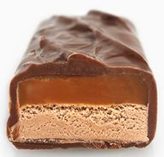
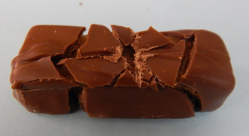
Section 2 Activity: Milky Way
1. What layers of the Earth are represented by the candy bar?
LITHOSPHERE
ASTHENOSPHERE
LOWER MANTLE
CRACKS IN THE TOP
LARGE CHOCOLATE PIECES
Use your finger to make several cracks in the chocolate.
Notes:
If you have any students with peanut (or other allergies), you will want to skip this activity and find an alternate one to complete.

Slide 21
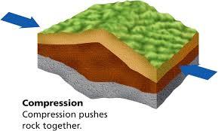
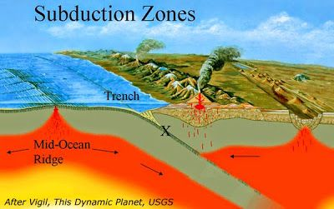
Observing Forces
COMPRESSION
Apply compression by slowly push the ends of the candy bar towards the middle by a couple centimeters.
What do you observe? Enter it on your slide and add arrows.
Pushes plates together; uplifts & subduction;
convergent boundary

Slide 22
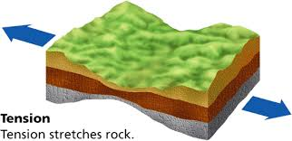
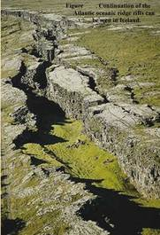
TENSION
Apply tension by pulling the ends of the candy bar away from the middle by a couple centimeters.
What do you observe? Enter it on your slide and add arrows.
Pushes plates together; uplifts & subduction; convergent boundary
Pulls plates apart; see gaps or valleys
; divergent boundary

Slide 23
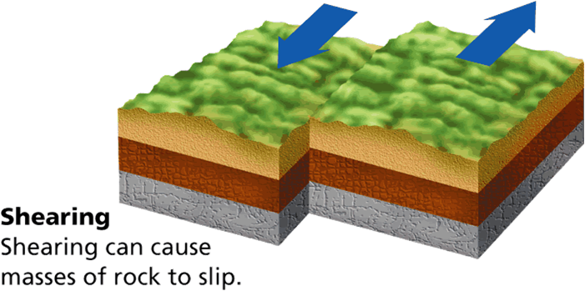
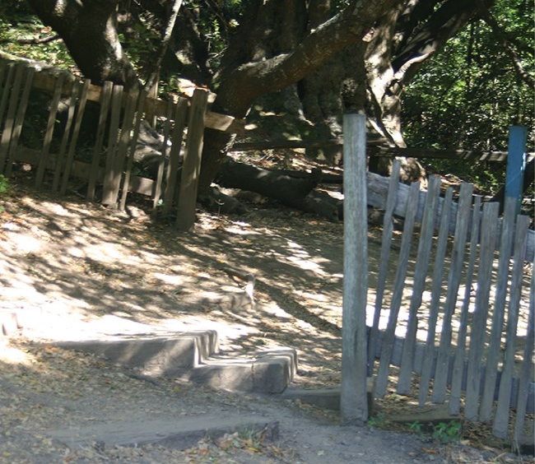
SHEARING
Push the candy bar back into its original position (as close as you can.)
Apply a shearing force by pushing one end to the left and the other to the right.
What do you observe? Enter it on your slide and add arrows.
Pushes plates together; uplifts & subduction; convergent boundary
Plates move past one another horizontally
; transform boundary
Pulls plates apart; see gaps or valleys; divergent boundary
You may eat your candy bar!

Slide 24
Explore more …
https://www.amnh.org/explore/ology/earth/plates-on-the-move2/game
Which plates make up each type of boundary? Find two examples for each & add to your slide.
Convergent
Divergent
Transform

Slide 25
Section 3
Section 3 Video Segment 40:36-56:44
Section 3 Activity
http://documentaries-plus.blogspot.com/2012/06/inside-planet-earth-discovery-channel.html

Slide 26
What precious material is found here? How did they get to where they are today? Diamond from violent eruptions
Why do geologists like the “flaws” in them? They are fragments of primitive mantle.
True or False: All diamonds from across the world are identical in composition.
4. What devastating phenomenon originates at this level? Earthquakes
5. Seismic data can tell us the shapes of certain features inside of the Earth.
6. Convection currents of hot solid rock move continuously throughout the mantle, which causes the tectonic plates to shift.
7. Which plates have a greater density? Continental or Oceanic (choose one)
Kimberlite = Igneous rock with diamonds in them

Slide 27
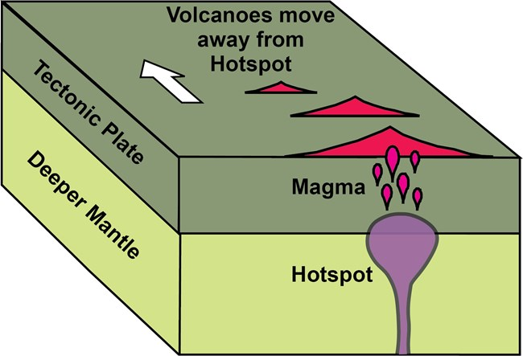
8. If all underground water came to the surface, sea levels would rise 2.5 miles above the peak of Mt. Everest.
9. What is the Ring of Fire? Area of explosive volcanoes around the Pacific Plate
10. What do plumes from then mantle create? Hot spot volcanoes
11. Measured from the ocean floor, where is the tallest volcano in the world located? Hawaii
12. Why/How do island chains form? The plume stays in one place, while the plate above it is moving.
Watch the animation:
https://www.youtube.com/watch?v=7bOTFk7P_1g

Slide 28
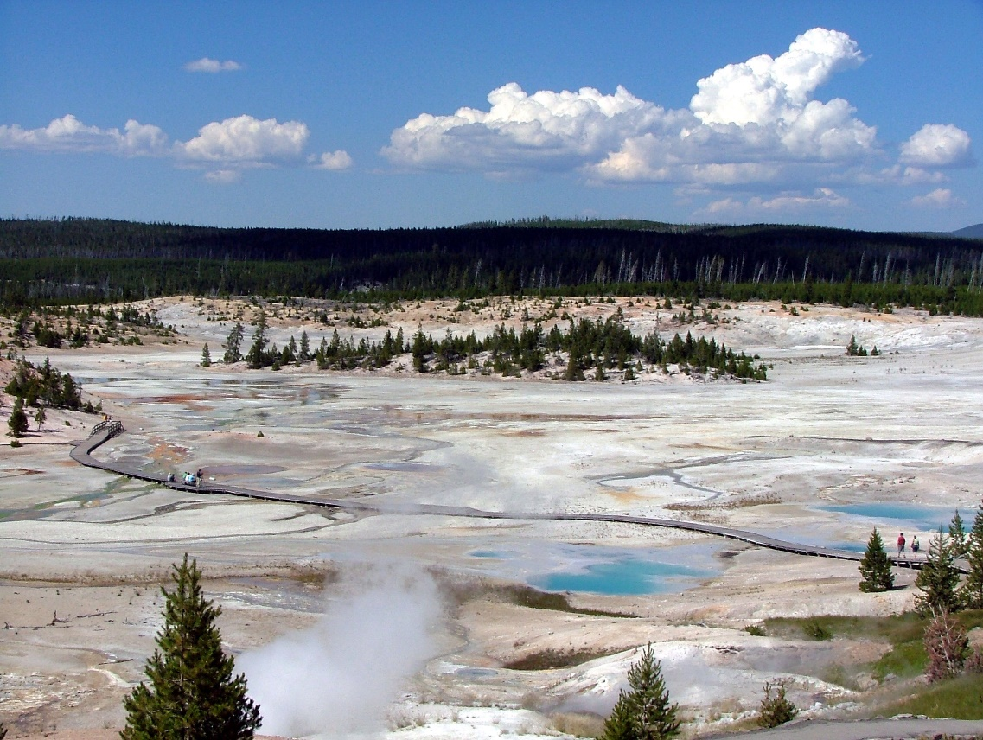
13. A total of 3 destructive eruptions have occurred at Yellowstone, which is a giant volcano.
14. What would happen if the Yellowstone volcano erupted? Billions of tons of ash would be shot into the air blocking out the sun causing a volcanic winter.
Research It … Use online resources to answer these questions about the Yellowstone volcano. Share your answers with the teacher and your classmates.
When did it last erupt?
How is it classified?
Why causes the geysers?
When is it expected to erupt?
Sci Show - https://www.youtube.com/watch?v=v0c7wcpJslg

Slide 29
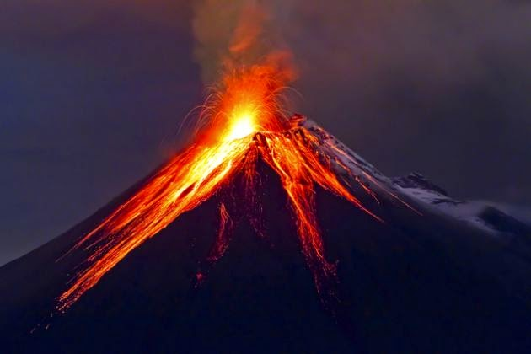
National Geographic Volcanoes 101
Click the picture to watch the video and then answer the questions on the next slide.
This Photo by Unknown Author is licensed under CC BY-NC

Slide 30
✰ Volcanoes 101 - Answer these questions after the video.
How many active volcanoes are there? A. 250 B. 500 C. Over 1000
Which tectonic plate is surrounded by the Ring of Fire? A. North American B. Atlantic C. Pacific
90% of earthquakes occur around the Ring of Fire. What percent of all volcanoes on Earth occur here? A. 50 B. 75 C. 90
How are volcanoes classified? A. Location B. Shape and size C. Last eruption
What do we call molten rock above the Earth’s surface? A. Magma B. Lava C. Pyroclastic flow
Which scale is used to rate the explosive power of a volcano? A. Mohs scale B. Richter scale C. VEI
The most destructive volcano ever witnessed was rated as a: |A. 6 B. 7 C. 8
True or False? Volcanoes are always destructive.
Explore More … Hawaii Volcano Tour

Slide 31
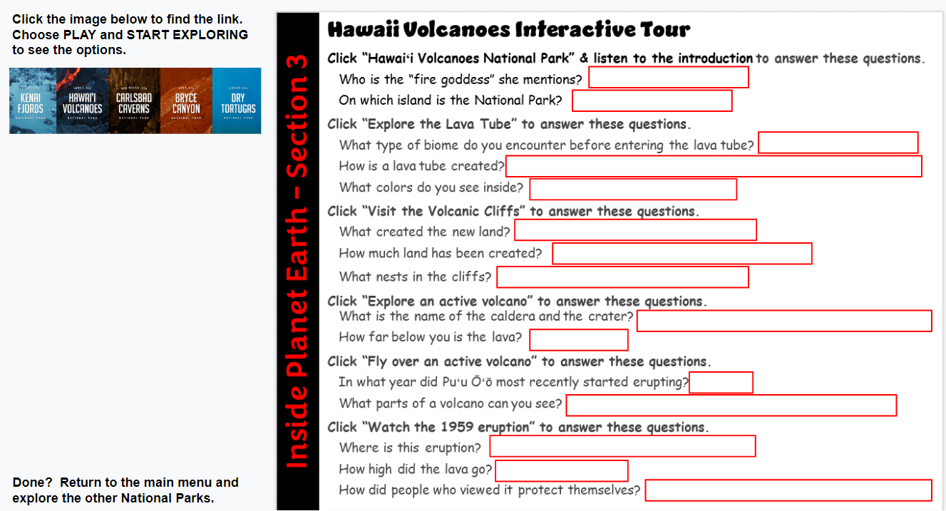
Time to explore a volcano …
Explore the other National Parks when you are done!

Slide 32
Section 4
Section 4 Video Segment 56:44-1:13:17
Section 4 Activity
http://documentaries-plus.blogspot.com/2012/06/inside-planet-earth-discovery-channel.html

Slide 33
The outer core is larger than the moon.
True or False: Seismic waves allow scientists to “see” the outer core.
3. Earth’s core produces a magnetic field, which protects us by creating a “magnetic bubble” that keeps the solar wind and radiation from reaching the Earth’s surface.
4. What are auroras? Lights in the sky caused by battle between the magnetic field from the core and solar radiation.
5. Why were the astronauts exposed to the cosmic rays? They were at the edge of the safety shield created by Earth’s magnetic field.
6. What are the shape of the columns formed in the core? Helix or Helical
7. Due to the iron, there are also electrical currents in the core. Without heat & rotation, the core wouldn’t generate a magnetic field.

Slide 34
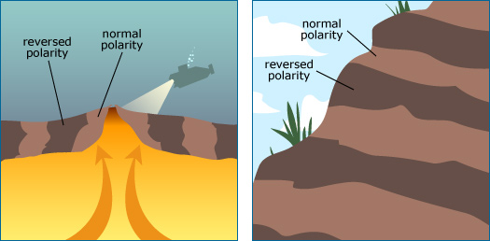
8. Over the past century, the strength of Earth’s magnetic field has decreased by 10 percent.
9. What is the South Atlantic Anomaly? A weak area in our magnetic field (up to 1/3 less than normal)
10. What happens during a “reversal”? North and South poles switch
11. Where can we find evidence of reversals that have occurred in the past? Inside cooled lava → crystals line up with the direction of the magnetic field
12. During a reversal, we would lose protection from the magnetic field for several months.

Slide 35
Section 4 Activity – Ride the Rock Cycle
Fill in #1-3 as we watch the video in class.
https://edpuzzle.com/media/627a8775d1fb52430c3fdef7

Slide 36
Part A: Study Jams- Watch the video to complete this section and then do the quiz.
1. Heat and pressure melts rock and turns it into . When it cools it becomes rock.
2. Igneous rock can be broken down by and the pieces moved around by erosion. The mix of pieces become rock, such as limestone.
3. Weight and pressure creates heat causing the rock to turn into rock, such as marble.
4. Clicking the Test Yourself button. How did you do? ____ out of 7
METAMORPHIC
MAGMA
IGNEOUS
WEATHERING
SEDIMENTARY
SEDIMENTARY
METAMORPHIC
?

Slide 37
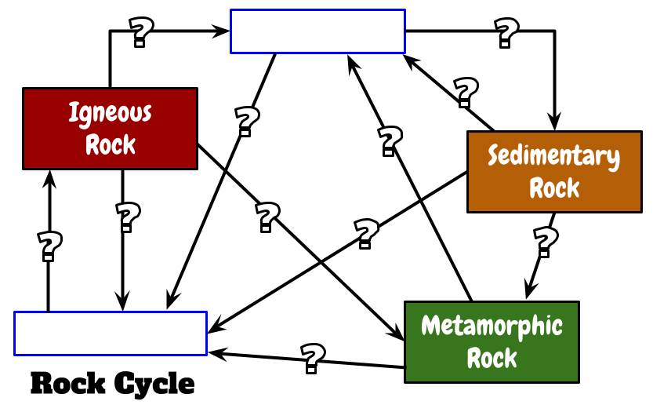
Section 4 Activity – Ride the Rock Cycle
START

Slide 38
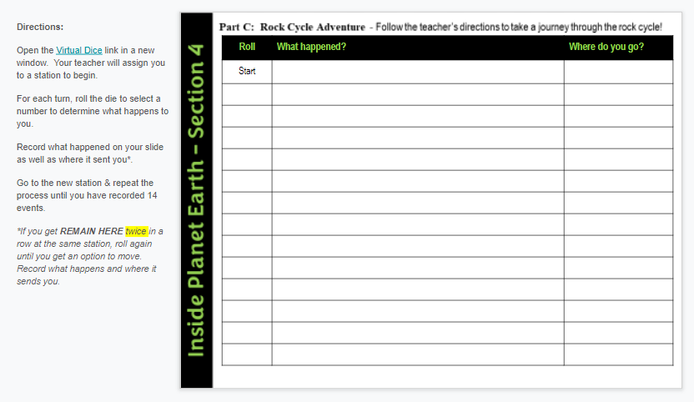
Rock Cycle
Follow the directions to complete an adventure on the rock cycle.
Clouds
Snowflakes with ash/dust
Mountains
6
Rock is broken down, erosion
Soil
Starting Stations
1 = SOIL
2 = RIVER
3 = OCEAN
4 = CLOUDS
5 = MOUNTAINS
6 = EARTH’S LAYERS
7 = VOLCANO
You will have time to finish tomorrow (if needed)
Notes:
Ride the Rock Cycle Lesson: Go to https://middleschoolscience.com/2016/08/03/ride-the-rock-cycle-comic-strip-adventure/ for the lesson resources and more details.
I would recommend assigning the comic strip after you complete the Rock Box activity to give students background information on different types of rocks.

Slide 39
Answer these questions about your adventure.
1. How many different stations did you visit?
2. Which station(s) did you visit the most often?
3. If you were to track your adventure based on the rock cycle we discussed in Part B, how many times did you undergo the processes listed below?
Weathering, erosion, & deposition
Melting, cooling, & crystallization
Great heat & pressure
4. Which different types of rocks did you experience? When?
Igneous
Sedimentary
Metamorphic

Slide 40
Section 5
Section 5 Video Segment 1:13:17-End
Section 5 Activity
http://documentaries-plus.blogspot.com/2012/06/inside-planet-earth-discovery-channel.html

Slide 41
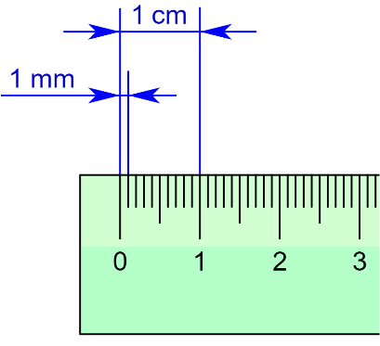
1 mm = Thickness of a fingernail
Why is the material solid in the inner core? Very high amounts of pressure
The inner core is growing at a rate of 1 millimeter per year.
True or False: We know exactly what the surface of the inner core looks like.
One day, the inner core will freeze solid.
What happened to the heavier materials during planetary formation? The material sank to the bottom/center of the newly formed planets.
How large was the object that made the crater in Arizona? 300-400 ft
7. Water once flowed on the surface of Mars.
This Photo by Unknown Author is licensed under CC BY-SA
Did you know … In 2004, Long John Silvers gave away shrimp to celebrate the finding of an ocean on Mars. Do research to explain how scientists figured this out!

Slide 42
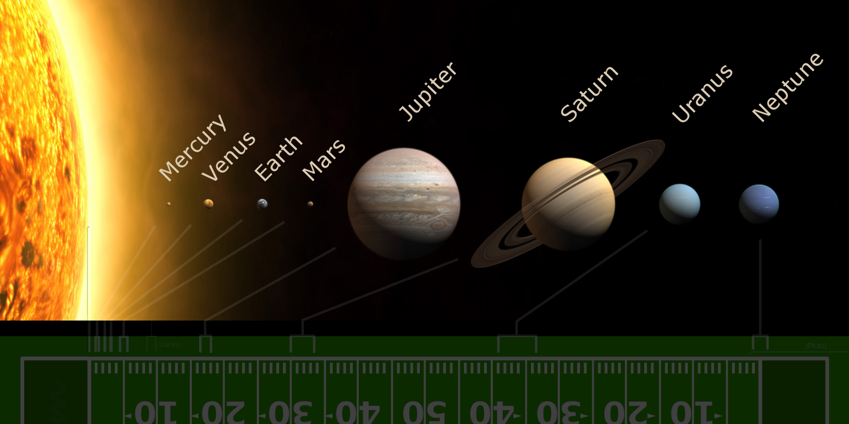
Mars’ magnetic field is weak, but its crust is very magnetized.
Why did Mars’ magnetic field collapse? Its core froze solid
Mars core only lasted a few 100 million years.
Compared to Earth, why did Mars core cool so quickly?
Mars is only half the size of Earth.
This Photo by Unknown Author is licensed under CC BY-SA

Slide 43
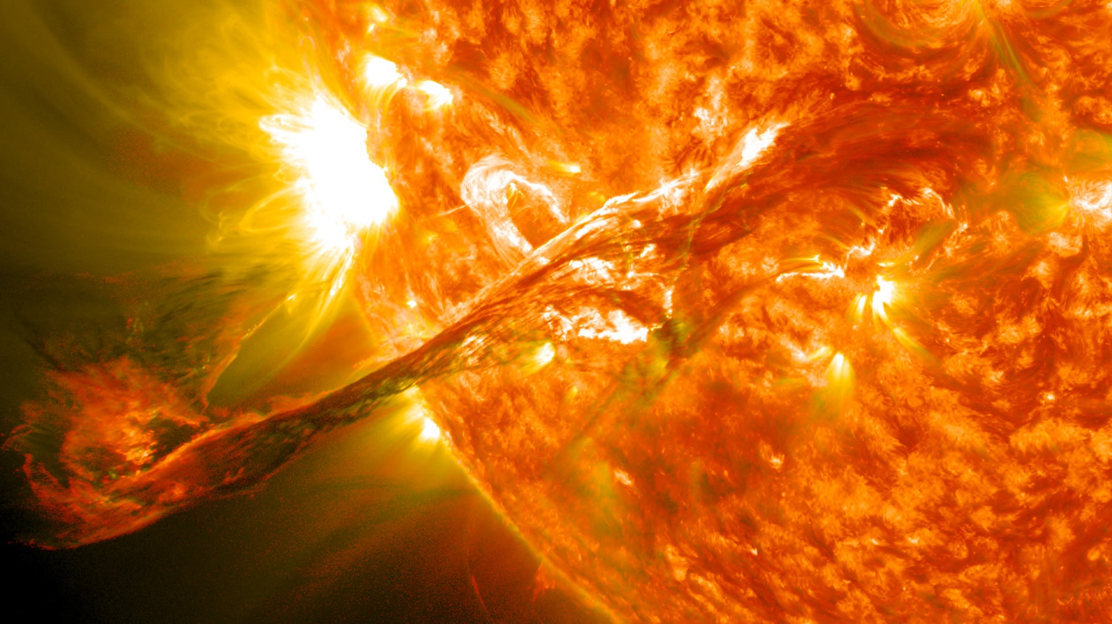
12. Temperatures in the inner core reach 12000 degrees Fahrenheit, which is hotter than the surface of the sun.
13. There is no gravity in the center of the Earth.
Do you know … How hot is the surface of the sun?
This Photo by Unknown Author is licensed under CC BY

Slide 44
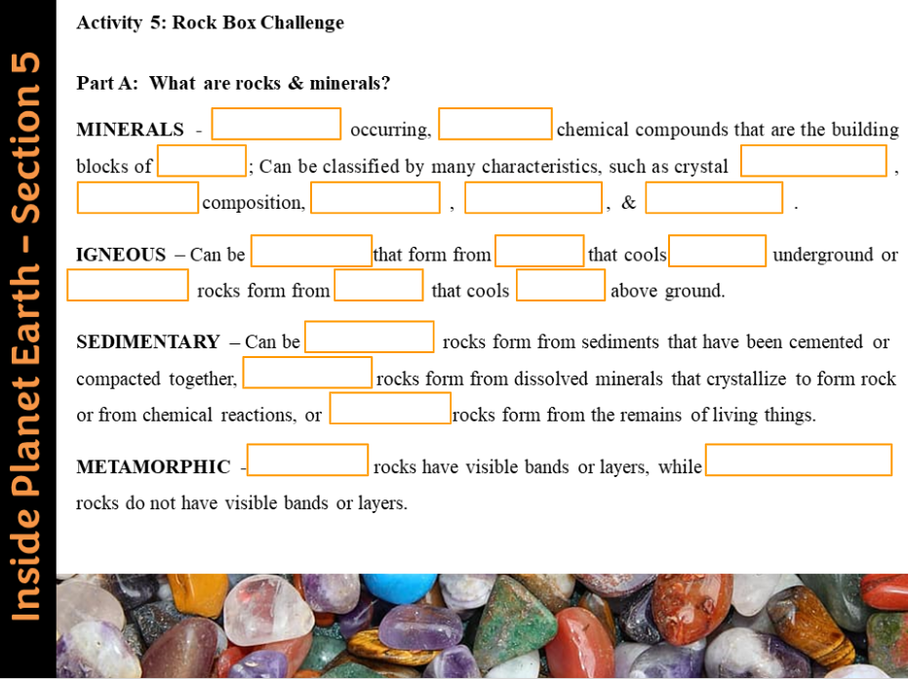
Section 5 Activity - Rock Box Challenge
Directions: Fill in the notes as we discuss them in class. You will use this information to help you identify the mystery samples in your rock box.
Teacher Information – Go to the next slide for more details about this activity.

Slide 45
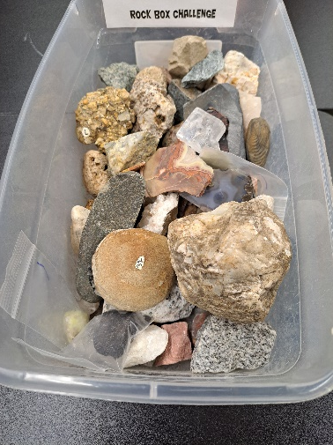
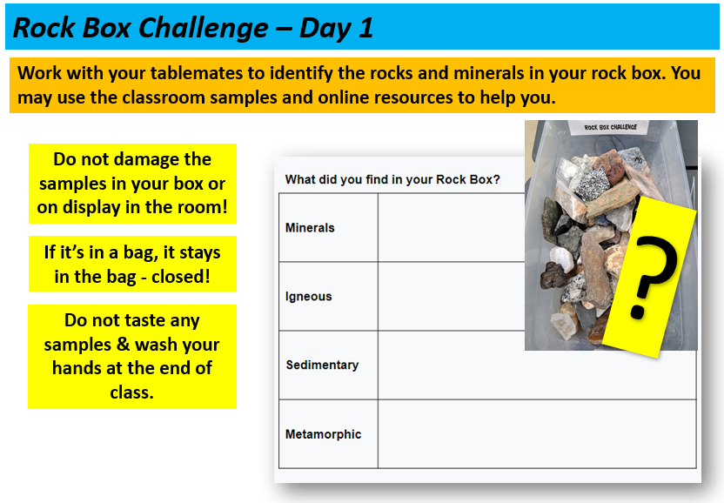
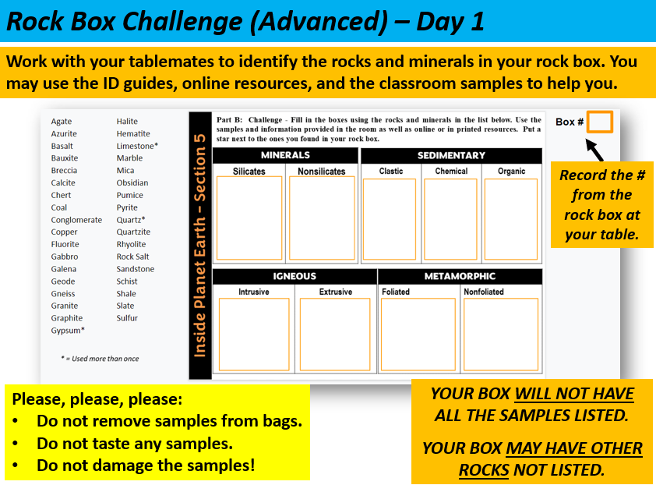
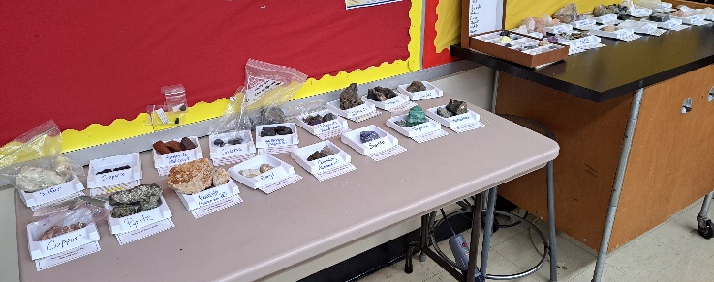
Rock Box Teacher Information
For this activity, I separated my various collections of rocks and minerals into seven “rock boxes” – one for each table group in my classroom. Each box contained at least 30 samples.
I set up displays in my room with stations for minerals, sedimentary rocks, igneous rocks, and metamorphic rocks. I also provided identification guides, links to online resources, and tools they could use (hand lenses, vinegar, streak plates, magnets, etc.)
The students worked as teams to identify as many of the samples as they could. Depending on the time you have available, students can complete the basic chart or go more in-depth by classifying their finds into the different categories (advanced chart). The student digital notebook includes slides for both versions – basic and advanced. For the advanced slide, you will want to edit the list of samples listed on the student slide based on what you have available.
Basic
Advanced

Slide 46
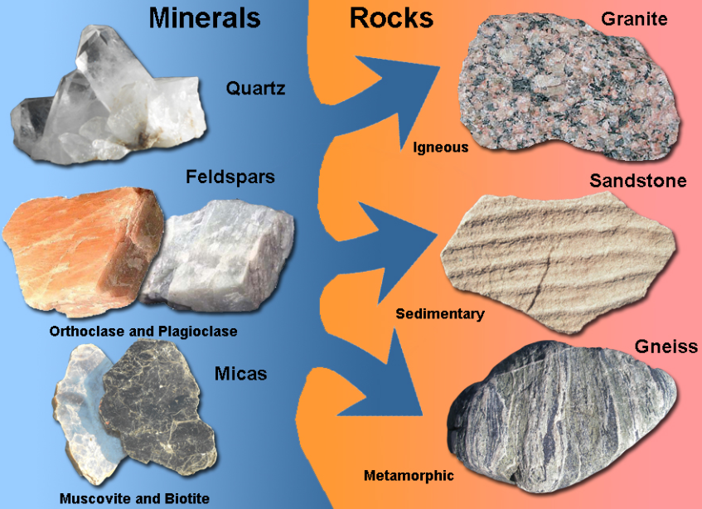
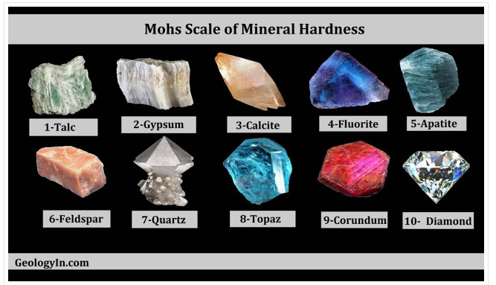
Rock Box Notes
MINERALS
→____________ occurring, __________ chemical compounds
→ Building blocks of ___________
NATURALLY
INORGANIC
ROCKS
SHAPE/ COLOR
→ Can be classified by many characteristics, such as crystal _______, __________ composition, ___________, _________ & _________.
CHEMICAL
HARDNESS
LUSTER
STREAK
What mineral is the hardest? Softest?

Slide 47
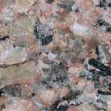
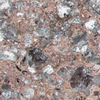
IGNEOUS - Rocks formed from molten rock
→____________ rocks form from ____________that cools ________ underground (larger crystals).
→_____________ rocks form from _________ that cools _________ above ground (smaller crystals.)
INTRUSIVE
MAGMA
SLOWLY
EXTRUSIVE
LAVA
QUICKLY
GRANITE Cools slowly = Large crystals
RHYOLITE
Cools quickly = Small Crystals
“Chemical Cousins”

Slide 48
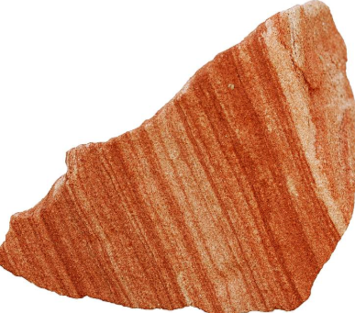
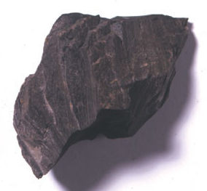
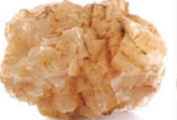
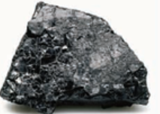
SEDIMENTARY - Rocks formed from sediments or other compounds
→ _________ rocks form from sediments that have been cemented/compacted together; may find fossils between the layers
→ __________ rocks form as dissolved minerals in a solution crystallize to form rock or form from chemical reactions.
→ ____________ rocks form from the remains of living things (compacted or cemented together)
SANDSTONE
CLASTIC
CHEMICAL
SHALE (MUDSTONE)
ORGANIC
ROCK SALT
AGATE (QUARTZ)
COAL
COQUINA

Slide 49
METAMORPHIC - Rocks changed by great heat and pressure or chemical reactions.
___________ rocks have visible bands or layers (form from sedimentary rocks with bedding)
→ ______________ rocks do not have visible bands or layers
FOLIATED
NONFOLIATED
GNEISS
QUARTZITE
(from sandstone)
MARBLE
(from limestone)
SLATE
(from shale)
SCHIST

Slide 50
Rock Box Challenge
Work with your tablemates to identify the rocks and minerals in your rock box. You may use the classroom samples and online resources to help you.
Do not damage the samples in your box or on display in the room!
?
If it’s in a bag, it stays in the bag - closed!
Do not taste any samples & wash your hands at the end of class.
You will have time to work on this activity tomorrow!

Slide 51
Rock Box Challenge - Conclusion
Compare your results to those of another team by discussing these questions:
How many of each category did your team identify?
Minerals = _____ Igneous = _____ Sedimentary = _____ Metamorphic = _____
Did your team have samples that could not be identified? If yes, which ones?
Compare your results to those of another team. How do your results compare to the other group’s results?
Time to review … Quizlet Vocabulary Challenge!
GimKit Inside Planet Earth Kit

Slide 52
Rock Box Challenge (Advanced)
Work with your tablemates to identify the rocks and minerals in your rock box. You may use the ID guides, online resources, and the classroom samples to help you.
Do not damage the samples in your box or on display in the room!
Record the # from the rock box at your table.
If it’s in a bag, it stays in the bag - closed!
Do not taste any samples & wash your hands at the end of class.
YOUR BOX WILL NOT HAVE ALL THE SAMPLES DISPLAYED IN THE ROOM.

Slide 53
= Extra – not on list * = Listed more than once!
ANSWER KEY – If you are done!
Agate* Gypsum
Mica
Quartz
Calcite Fluorite Galena Graphite Gypsum
Hematite
Pyrite
Halite
Breccia
Conglomerate
Sandstone
Limestone *
Agate*
Quartz*
Geode
Chert
Limestone*
Rock Salt*
Coal
Sulfur
Quartz*
Limestone*
Gabbro
Granite
Diorite
Andesite
Basalt
Rhyolite
Pumice Obsidian
Scoria
Gneiss
Slate
Schist
Marble
Quartzite

Slide 54
Rock Box Challenge (Advanced) - Conclusion
How many of each category was your group able to identify?
Minerals = ____ Igneous = ____ Sedimentary = ____ Metamorphic = _____
How many samples were not identified? ______
Compare your results to those of another team. How do your results compare to the other group’s results?
Time to review … Quizlet Vocabulary Challenge!
GimKit Inside Planet Earth Kit

