Slide 1
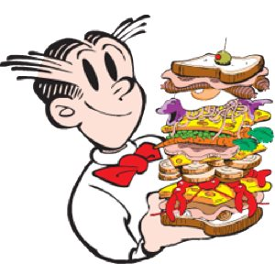
Sandwich Science
Nature of Science Unit
7th & 8th Grade Science
This Photo by Unknown Author is licensed under CC BY-SA-NC
Presentation by T. Tomm 2019 http:/sciencespot.net/

Slide 2
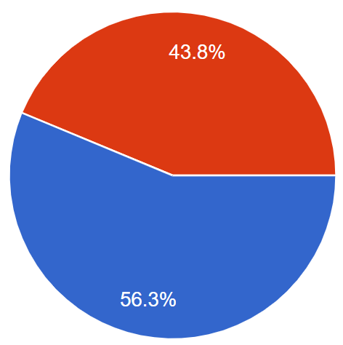
Is a hot dog considered a sandwich?
Your results are:
This Photo by Unknown Author is licensed under CC BY

Slide 3
Initial Discussion: How can we decide if a hot dog is a sandwich or not?
What is your definition for a hot dog?
Is it a specific type of meat or shape?
Does it include a bun/bread?
Are there other qualifications/limitations?
How does your definition of a hot dog compare to your tablemates?
Did you base your decision on evidence?
If so, what “proof” do you have?
Is this proof credible (believable/based on data)?

Slide 4
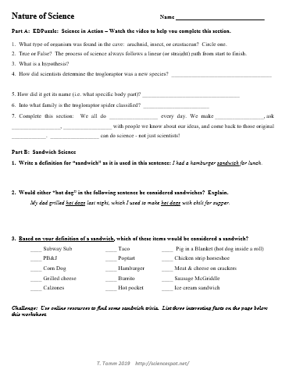
Glue the worksheet on page ____.
Watch the EDPuzzle video – “Science in Action” to complete the Part A.
Complete #1-3 in Part B on your own.
You may use online resources to help you write the definition.

Slide 5
Part A: EDPuzzle: Science in Action
1. What type of organism was found in the cave: arachnid, insect, or crustacean? Circle one.
2. True or False? The process of science always follows a linear (or straight) path from start to finish.
3. What is a hypothesis?
4. How did scientists determine the trogloraptor was a new species?
Think About It: How is a pinball game a better description of the scientific process?
An educated guess or possible answer to a question based on our observations and knowledge.
They did a detailed study of all the spider species that have been identified and found it did not match any of those.
Video Link: https://edpuzzle.com/media/5d5d4bd13284f3407c9a6dac

Slide 6
5. How did it get its name (i.e. what specific body part)?
6. Into what family is the trogloraptor spider classified?
7. Complete this section: We all do _______ every day. We make _____________, ask ___________, ______________ with people we know about our ideas, and come back to those original________. _______________ can do science - not just scientists!
Its name came from the unique design of its claw
Goblin spider (New family)
science
observations
questions
communicate
ideas
Everyone
Think About It: What were all the different ways scientists shared their knowledge and ideas?

Slide 7
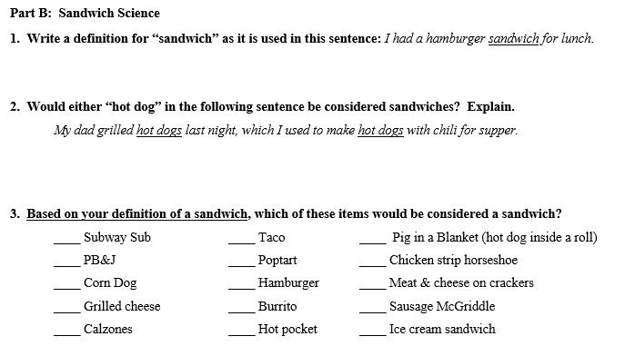
Part B: Sandwich Science
How do your responses compare to those of your classmates? Take a few moments to compare your responses.

Slide 8
Many of your definitions for sandwich had several things in common:
1 – A sandwich was food.
2 – A sandwich had a filling of some sort.
3 – A sandwich had to include at least one piece of bread/pastry.
Therefore, a class definition for a sandwich would be …
A sandwich is a food consisting of 1 or more pieces of bread (or other pastry) with a filling.
Pastry = baked product?

Slide 9
Based on our class definition for a sandwich, which items could be considered a sandwich?
A sandwich is a food consisting of 1 or more pieces of bread (or other pastry) with a filling.
?

Slide 10
As we saw in the video, there are different families of spiders based on the differences in their physical characteristics, anatomy, behaviors, etc.
Are there different types of “sandwiches”?
If so, what “families” of sandwiches could we have?
How would we describe each family; i.e. what characteristics would each have?

Slide 11
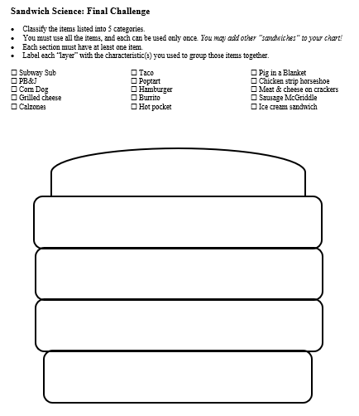
Work with your tablemates to develop 5 families to complete the Final Challenge worksheet.
We will share our classification structures tomorrow!
Need more than 5 families? Draw a line to divide a layer in two parts.

Slide 12
How does this activity relate to the EDPuzzle video you watched about the spider?
Classifying Spiders | Classifying Sandwiches
Notes:
Some possible answers are:
We asked questions.
We made observations.
We communicated our ideas and got feedback from our peers.
We changed our ideas or opinions based on a definition we all agreed upon.
We used our past observations and knowledge to make new hypothesis (i.e. whether something was a sandwich)
We worked together (collaborated)
We based our decisions on specific information (bun/no bun, meat/no meat) and not random opinions.
We defined a problem in terms that we were sure we all discussed the same things.

Slide 13
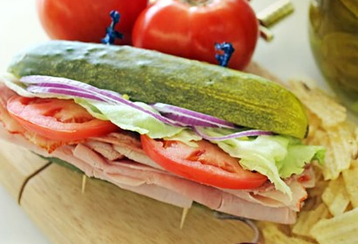
Is this a sandwich based on our definition?
Scientific Definition - A sandwich is a food consisting of 1 or more pieces of bread (or other pastry) with a filling.
It would not be a sandwich based on the “scientific definition” – no bread.

