Slide 1
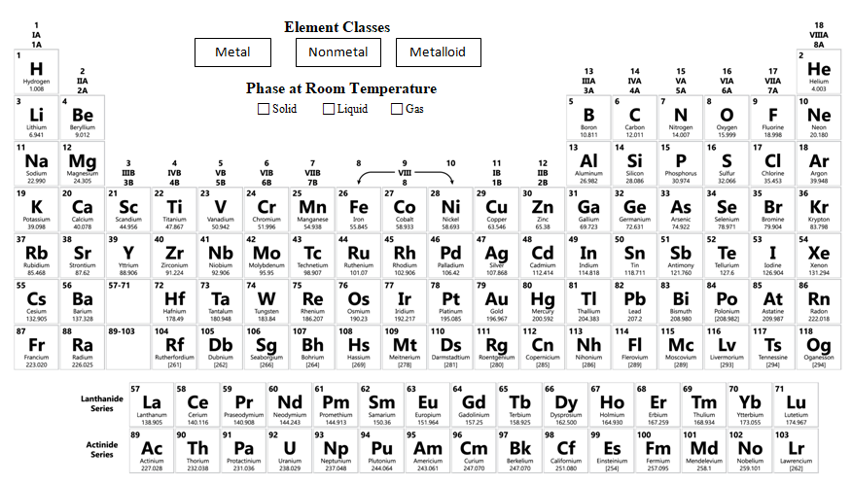
Periodic Table Coloring Activity
Follow each step to create your own coded table.
You will need a pen and colored pencils.
Be sure you can still read everything when you are done as you’ll need this page for other assignments and activities!
PowerPoint developed by T. Tomm Updated January 2019 http://sciencespot.net/

Slide 2
METALS, NONMETALS, or METALLOIDS.
Read this information!
Source: http://images.slideplayer.com/26/8456696/slides/slide_9.jpg

Slide 3
OUTLINE these boxes in RED and OUTLINE the NONMETALS box in the key.
STEP 1

Slide 4
Use BLUE to OUTLINE the boxes for the METALLOIDS and OUTLINE the key.
STEP 2

Slide 5
OUTLINE these boxes in GREEN for METALS and OUTLINE the key.
STEP 3

Slide 6
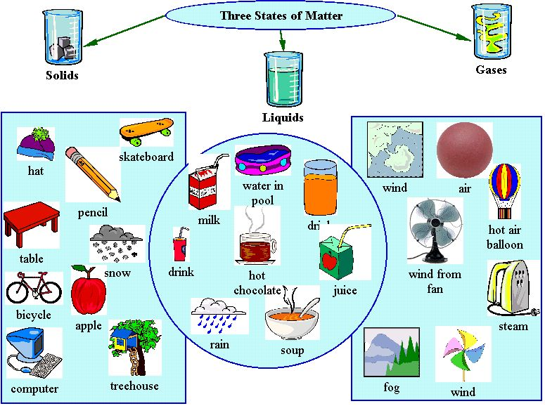
What’s the phase?
Read this information!
Elements in a periodic table are shown with their states at room temperature.
Source: http://www.learnnc.org/lp/media/lessons/Indianajennette2112003807/ThreeStatesofMatter.jpg

Slide 7
Draw a BLACK WATER DROPLET (or DOT) to show the elements that are LIQUID at room temperature.
STEP 4

Slide 8
Draw a RED BALLOON (or DOT) to show the elements that are GASES at room temperature.
STEP 5

Slide 9
What about all the other elements? They are SOLIDS at room temperature and we will not mark those.
STEP 6
(You don’t really have to do anything for this step!)

Slide 10
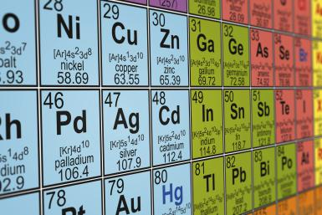
Element Families or Groups
Read this information!
Elements are organized into families (or groups) based on the number of valence electrons they have, which determines their reactivity and other properties.
Source: http://f.tqn.com/y/chemistry/1/W/J/V/2/186810031.jpg
You will need COLORED PENCILS to LIGHTLY shade in the boxes and a PEN to label each column.

Slide 11
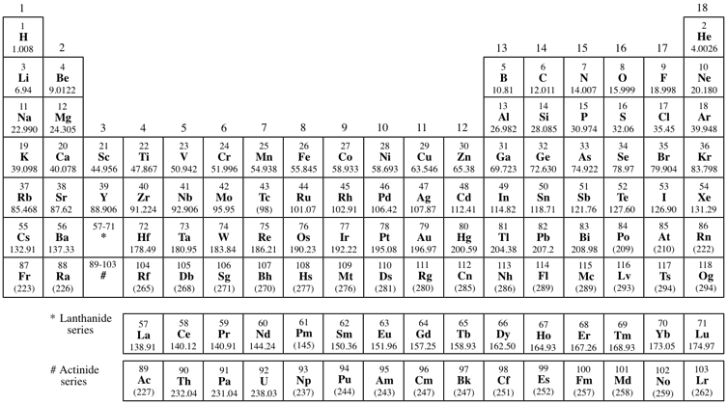
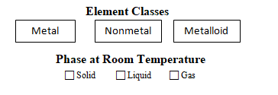
Column #1 – Alkali Metals → Shade all elements (except H) in GREEN & add the name at the top.
Alkali Metals
Be sure to label EACH column with its name!
STEP 7

Slide 12
Column #2 – Alkaline Earth Metals → Shade all elements BLUE & add the name at the top.
Alkali Metals
Alkaline Earth Metals
STEP 8

Slide 13
Groups #3-12 – Transition Metals→ NO COLOR, but you need to label Groups 3-12 as shown.
Alkali Metals
Alkaline Earth Metals
Transition Metals (Groups 3-12)
STEP 9

Slide 14
Column #13 – Boron Family → Shade all elements ORANGE & add the name at the top.
Alkali Metals
Alkaline Earth Metals
Boron Family
Transition Metals (Groups 3-12)
STEP 10

Slide 15
Column #14 – Carbon Family → Shade all elements RED & add the name at the top.
Alkali Metals
Alkaline Earth Metals
Boron Family
Transition Metals (Groups 3-12)
Carbon Family
STEP 11

Slide 16
Column #15 – Nitrogen Family → Shade all elements BROWN (or light tan) & add the name at the top.
Nitrogen Family
Alkali Metals
Alkaline Earth Metals
Boron Family
Transition Metals (Groups 3-12)
Carbon Family
STEP 12

Slide 17
Column #16 – Oxygen Family (Chalcogens) → Shade all elements PINK & add the names at the top.
Nitrogen Family
Alkali Metals
Alkaline Earth Metals
Boron Family
Oxygen Family
(Chalcogen)
Transition Metals (Groups 3-12)
Carbon Family
STEP 13

Slide 18
Column #17 – Halide Family → Shade all elements PURPLE & add the names at the top.
Nitrogen Family
Halogens (Halides)
Alkali Metals
Alkaline Earth Metals
Transition Metals (Groups 3-12)
Boron Family
Oxygen Family
(Chalcogen)
Carbon Family
STEP 14

Slide 19
Column #18 – Noble Gases → Shade all elements YELLOW & add the name at the top.
Halogens (Halides)
Nitrogen Family
Alkali Metals
Alkaline Earth Metals
Noble Gases
Boron Family
Oxygen Family
(Chalcogen)
Transition Metals (Groups 3-12)
Carbon Family
STEP 15

Slide 20
Periods (Rows)
Read this information!
Each row in the table is called a PERIOD. All the elements in a row have the same number of energy levels.
Source: http://images.slideplayer.com/18/5702901/slides/slide_1.jpg

Slide 21
The rows in the table make up PERIODS. Label each ROW with the number of energy levels (circles) it has.
Halogens (Halides)
Nitrogen Family
Alkali Metals
Alkaline Earth Metals
Noble Gases
Boron Family
Oxygen Family
(Chalcogen)
Transition Metals (Groups 3-12)
Carbon Family
1
2
3
4
5
6
7
6
7
STEP 16

Slide 22
15
16
17
1
18
2
13
14
Nitrogen Family
Halogens (Halides)
Alkali Metals
Alkaline Earth Metals
Noble Gases
Boron Family
Oxygen Family
(Chalcogen)
Transition Metals (Groups 3-12)
Carbon Family
1
2
3
4
5
6
7
How many valence electrons does each column have? Add the Lewis structures to your table!
6
7

Slide 23
Does your table resemble this one? If not, make additions and corrections!
5
6
7
1
8
2
3
4
Nitrogen Family
Halogens (Halides)
Alkali Metals
Alkaline Earth Metals
Noble Gases
Boron Family
Oxygen Family
(Chalcogen)
Transition Metals (Groups 3-12)
Carbon Family
1
2
3
4
5
6
7
6
7

Slide 24
Mystery Element Practice
= Group or Family
Same # of Valence Electrons
= Period
Same # of Energy Levels

Slide 25
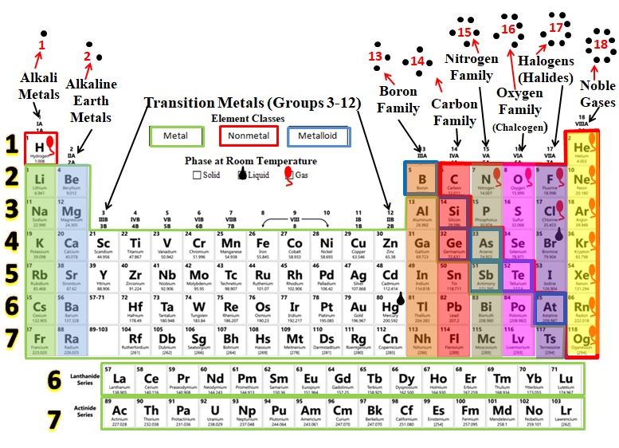
Use the CLUES to identify the mystery elements!

Slide 28
15
16
17
Halogens (Halides)
18
1
2
14
Nitrogen Family
Alkali Metals
Alkaline Earth Metals
Noble Gases
Boron Family
Oxygen Family
(Chalcogen)
Transition Metals (Groups 3-12)
Carbon Family
1
13
2
3
4
5
6
7
6
7

Slide 29
15
16
17
Halogens (Halides)
18
1
2
14
Nitrogen Family
Alkali Metals
Alkaline Earth Metals
Noble Gases
Boron Family
Oxygen Family
(Chalcogen)
Transition Metals (Groups 3-12)
Carbon Family
1
13
2
3
4
5
6
7
6
7

Slide 30
15
16
17
Halogens (Halides)
18
1
2
14
Nitrogen Family
Alkali Metals
Alkaline Earth Metals
Noble Gases
Boron Family
Oxygen Family
(Chalcogen)
Transition Metals (Groups 3-12)
Carbon Family
1
13
2
3
4
5
6
7
6
7

Slide 31
15
16
17
Halogens (Halides)
18
1
2
14
Nitrogen Family
Alkali Metals
Alkaline Earth Metals
Noble Gases
Boron Family
Oxygen Family
(Chalcogen)
Transition Metals (Groups 3-12)
Carbon Family
1
13
2
3
4
5
6
7
6
7

Slide 32
15
16
17
Halogens (Halides)
18
1
2
14
Nitrogen Family
Alkali Metals
Alkaline Earth Metals
Noble Gases
Boron Family
Oxygen Family
(Chalcogen)
Transition Metals (Groups 3-12)
Carbon Family
1
13
2
3
4
5
6
7
6
7

Slide 33
15
16
17
Halogens (Halides)
18
1
2
14
Nitrogen Family
Alkali Metals
Alkaline Earth Metals
Noble Gases
Boron Family
Oxygen Family
(Chalcogen)
Transition Metals (Groups 3-12)
Carbon Family
1
13
2
3
4
5
6
7
6
7

Slide 34
15
16
17
Halogens (Halides)
18
1
2
14
Nitrogen Family
Alkali Metals
Alkaline Earth Metals
Noble Gases
Boron Family
Oxygen Family
(Chalcogen)
Transition Metals (Groups 3-12)
Carbon Family
1
13
2
3
4
5
6
7
6
7

Slide 35
15
16
17
Halogens (Halides)
18
1
2
14
Nitrogen Family
Alkali Metals
Alkaline Earth Metals
Noble Gases
Boron Family
Oxygen Family
(Chalcogen)
Transition Metals (Groups 3-12)
Carbon Family
1
13
2
3
4
5
6
7
6
7

Slide 36
15
16
17
Halogens (Halides)
18
1
2
14
Nitrogen Family
Alkali Metals
Alkaline Earth Metals
Noble Gases
Boron Family
Oxygen Family
(Chalcogen)
Transition Metals (Groups 3-12)
Carbon Family
1
13
2
3
4
5
6
7
6
7

