Slide 1
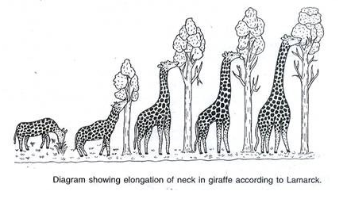
Living Things – Unit 2 Natural Selection
Student worksheets are available as Google Slides
Lesson developed by T. Tomm https://sciencespot.net/

Slide 2
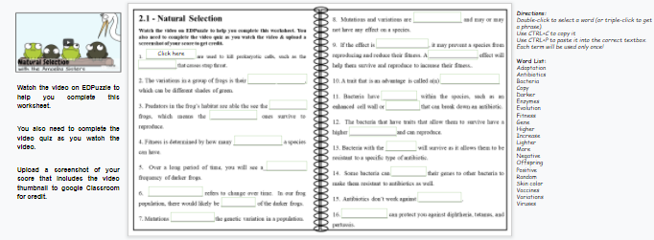
Natural Selection
Fill in the notes & answer the quiz questions as you watch the video on EDPuzzle.
Word List Directions:
Double-click to select a word (or triple-click to get a phrase).
Use CTRL+C to copy it
Use CTRL+P to paste it into the correct box.
Each term will be used only once!
Remember to use the rewatch button if you are unsure of a quiz questions.
Upload a screenshot of your video score and turn it in on Google Classroom to receive credit. Your quiz score will be counted as a grade!

Slide 3
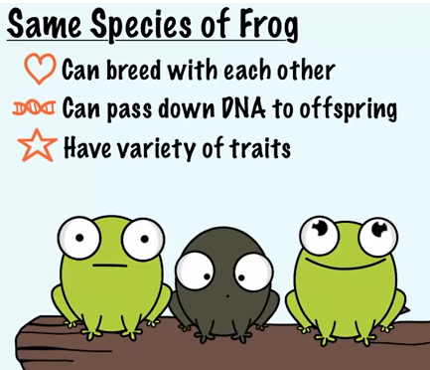
No nucleus
Natural Selection
1. __________________ are used to kill prokaryotic cells, such as the ______________ that causes strep throat.
2. The variations in a group of frogs is their __________ _________, which can be different shades of green.
3. Predators in the frog’s habitat are able the see the ____________ frogs, which means the _______________ ones survive to reproduce.
4. Fitness is determined by how many _______________ a species can have.
ANTIBIOTICS
BACTERIA
SKIN COLOR
LIGHTER
DARKER
OFFSPRING
Which is the biological definition of FITNESS?
The condition of being physically fit and healthy.
An organism's ability to survive and reproduce in a particular environment.
Health→
Biological →

Slide 4
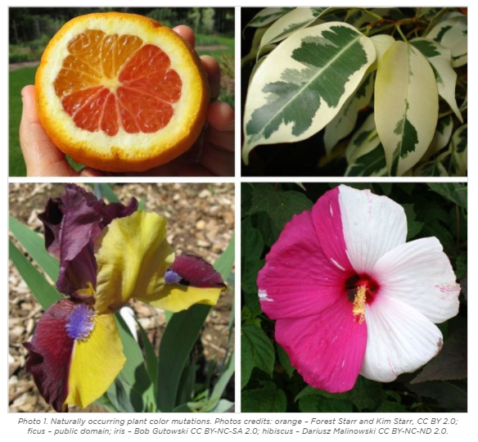
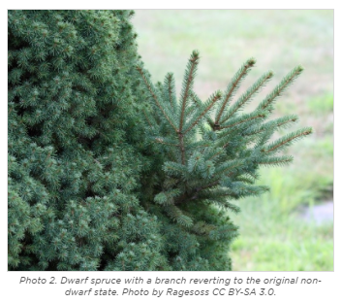
5. Over a long period of time, you will see a______________ frequency of darker frogs.
6. __________________ refers to change over time. In our frog population, there would likely be __________ of the darker frogs.
7. Mutations ______________ the genetic variation in a population.
HIGHER
EVOLUTION
MORE
INCREASE
Mutation = Change in genetic material (DNA)
Click the images to learn more about mutations.

Slide 5
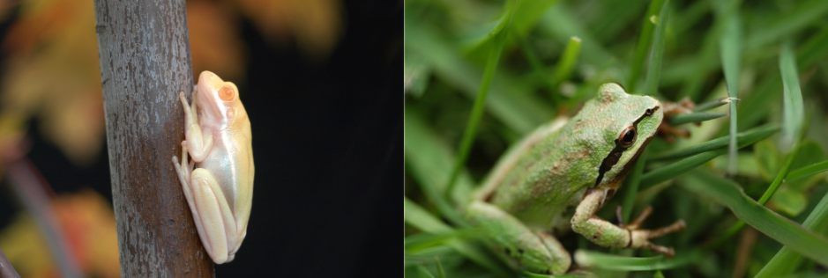
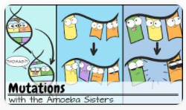
8. Mutations and variations are ______________ and may or may not have any effect on a species.
9. If the effect is _______________, it may prevent a species from reproducing and reduce their fitness. A ________________ effect will help them survive and reproduce to increase their fitness.
10. A trait that is an advantage is called a(n) ___________________
RANDOM
NEGATIVE
POSITIVE
Mutations can be +, -, or have no effect
ADAPTATION
Which of these would be a positive mutation? Why?
Positive traits = Better chances for reproduction =
Higher frequency in future generations.
https://www.sas.upenn.edu/~mkate/mutations_ms.html

Slide 6
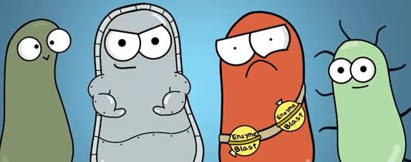
VARIATIONS
ENZYMES
11. Bacteria have __________________ within the species, such as an enhanced cell wall or _____________ that can break down an antibiotic.
12. The bacteria that have traits that allow them to survive have a higher ___________ and can reproduce.
13. Bacteria with the _________ will survive as it allows them to be resistant to a specific type of antibiotic.
14. Some bacteria can __________ their genes to other bacteria to make them resistant to antibiotics as well.
15. Antibiotics don’t work against _________________.
16. ________________ can protect you against diphtheria, tetanus, and pertussis.
FITNESS
GENE
COPY
VIRUSES
VACCINES
CELL WALL
ENZYMES

Slide 7
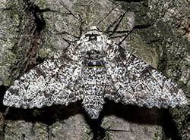
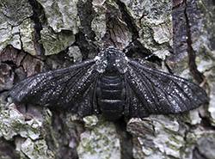
Living Things – Unit 2 Peppered Moths

Slide 8
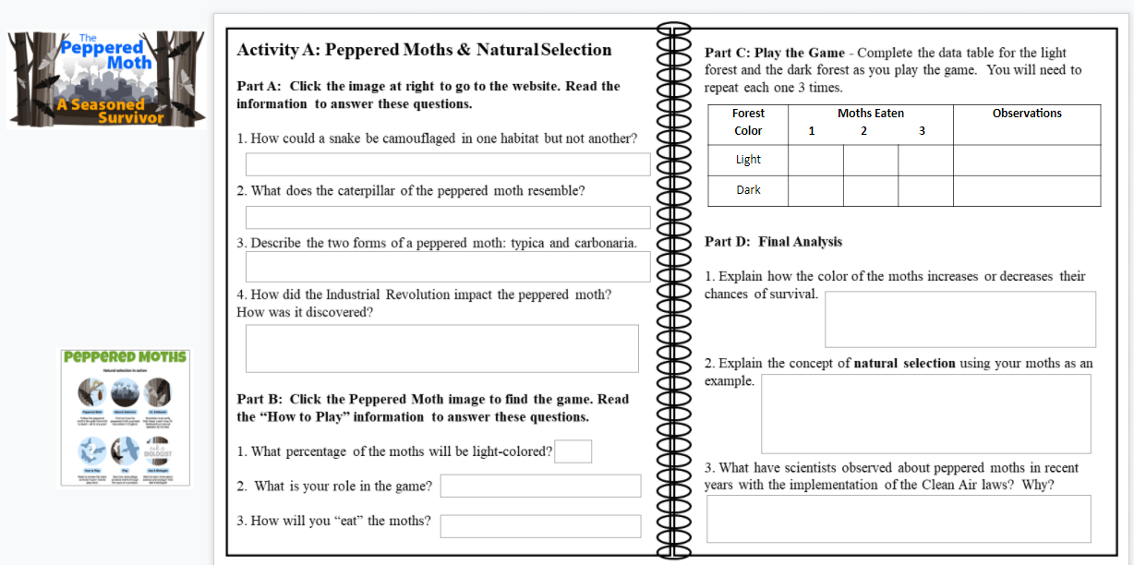
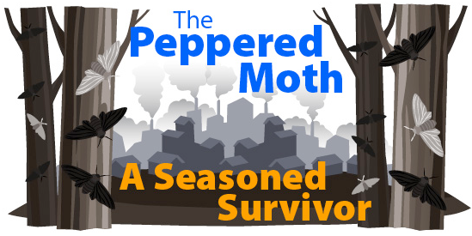
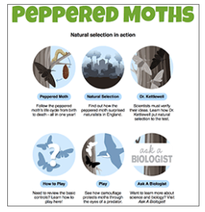
Slide #2: Peppered Moths: Seasoned Survivors
Use this website for Part A.
Use the table to record your data & observations.
Answer these questions when you are done with Part C.
Use this link to access the game.

Slide 9
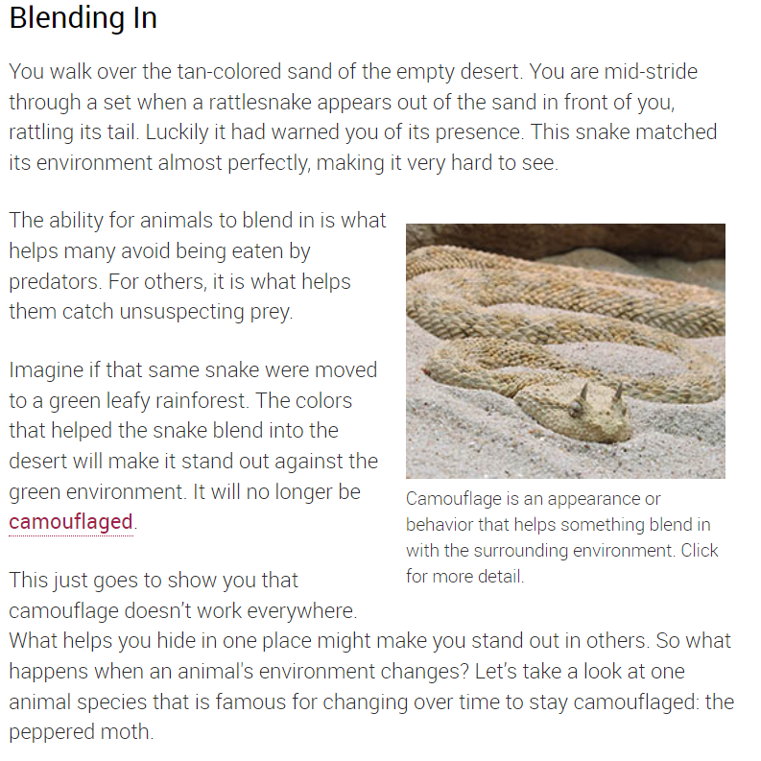
1. How could a snake be camouflaged in one habitat but not another?
A light-colored snake would blend in with sand but be very visible to predators in a green forest.

Slide 10
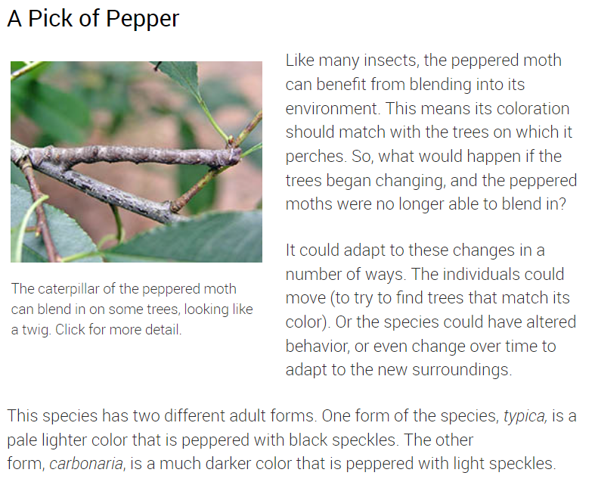
2. What does the caterpillar of the peppered moth resemble?
3. Describe the two forms of a peppered moth: typica and carbonaria.
It looks like a stick or twig.
Light-colored 
Dark-colored
Carbonaria
Typica
Mutation occurred in the DNA of the light moths

Slide 11
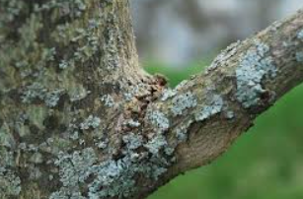
4. How did the Industrial Revolution impact the peppered moth? How was it discovered?
The factories BURNED COAL for energy
◉
Created POLLUTION
◉
Killed light-colored LICHEN and black SOOT turned the tree trunks dark.
LICHEN
Discovered by observing the habitats and moth collectors.

Slide 12
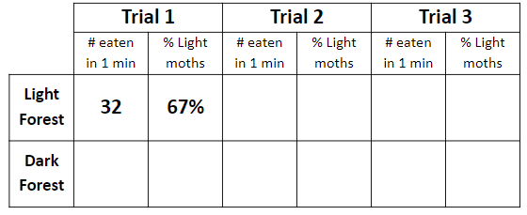
Part B: Click the Peppered Moth image to find the game. Read the “How to Play” information to answer these questions.
1. What percentage of the moths will be light-colored?
2. What is your role in the game?
3. How will you “eat” the moths?
50% (Half)
Predator (bird)
Click on them
Part C: Play the Game - Complete the data table for the light forest and the dark forest as you play the game. You will need to repeat each one 3 times.
Click NEW GAME to play again.
Record your data after each round!

Slide 13
Part D: Final Analysis
1. Explain how the color of the moths increases or decreases their chances of survival.
2. Explain the concept of natural selection using your moths as an example.
3. What have scientists observed about peppered moths in recent years with the implementation of the Clean Air laws? Why?
Light moths survived more often in the light forest, but the survived less often in the dark forest.
Lighter moths survived more often in the lighter forest, which means they were the ones to reproduce more often and have more offspring. The moths that survive have a higher fitness since they can produce offspring.
They have noticed more light moths, because decreased pollution has changed the trees back to a lighter color.

Slide 14
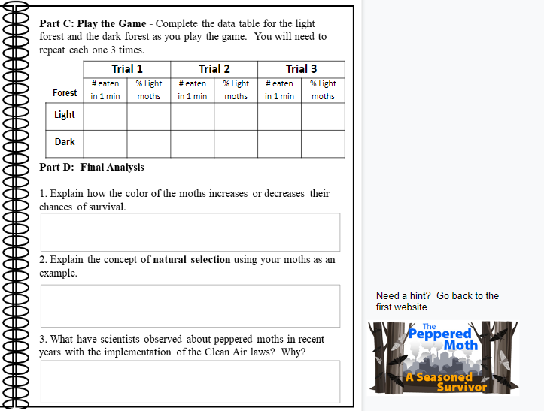
Go to Slide #3: Peppered Moths: Seasoned Survivors
Use the table to record your data & observations.
Click here for a hint!
Answer these questions when you are done with Part C.

Slide 15
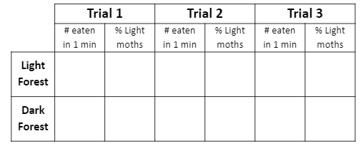
Part D: Final Analysis
1. Explain how the color of the moths increases or decreases their chances of survival.
32
67%
39
75%
46
83%
33
8%
46
33%
44
18%
Light moths - More survive in the light forest.
Less survive in the dark forest.
Dark moths – Opposite occurs (more die in light forest than dark one).

Slide 16
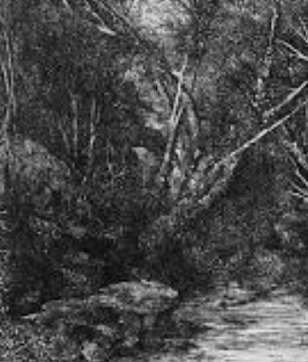
2. Explain the concept of natural selection using your moths as an example.
Dark colored moths are MORE likely to survive in a darker habitat.
More dark moths surviving and reproducing = more dark moths in future generations.
Typica
Higher Fitness in light forest
(Most common)
Mutation occurred to create darker moths
Carbonaria
Higher Fitness in dark forest
(Most common)
Light forest
Dark forest

Slide 17
3. What have scientists observed about peppered moths in recent years with the implementation of the Clean Air laws? Why?
Decreased pollution has helped the forest change back to a lighter color. This has allowed more light-colored moths to survive & reproduce – it is now the more common variation.
Typica
Carbonaria
Typica
Mutation occurred
?
Light forest
Dark forest

Slide 18
Quick Review
Carbonaria vs. Typica - Which is which?
Which of these factors resulted in the appearance of the darker peppered moths?
Pollution darkened the moths A mutation occurred
Disease killed the light moths All of these are correct
Which of these factors changed the habitat where peppered moths were found during the Industrial Revolution?
Pollution killed the lichen and darkened the trees
Disease killed the moths
Mutation occurred that resulted in darker moths
All of these are correct
How did the Clean Air laws affect the peppered moth habitat & the populations of moths?
T
C
Lichen began to grow again and less soot on the trees changed the habitat back to a lighter forest. The light-colored moth population grew since they were able to survive more often in the light habitat.

Slide 19
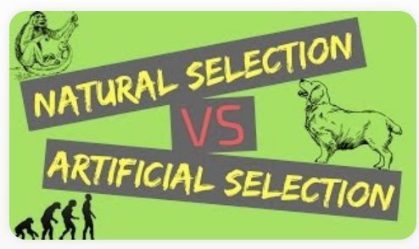
Natural Selection vs. Artificial Selection Watch the video to answer these questions.
1) What criteria are needed for artificial selection?
A. Variations in the population
B. Trait must be heritable (able to be passed along to another generation.)
C. Limits on population growth
2. What is the main difference between natural and artificial selection? A. Only natural selection affects organisms living in nature, artificial does not. B. Artificial selection is determined by humans. C. Natural selection is determined by humans.
3. Identify each example as natural or artificial selection.
____ Brown beetles survive more than green beetles and increase in population size.
____ Cows are breed with specific traits to produce a higher quality of milk.
____ Moths that are darker will survive better in a habitat that has been made darker from pollution.
____ A farmer pollinates an apple that is mall with one that is very sweet to get small, sweet apples.
____ The beaks of some finches change shape over several generations as the types of food they have available also changes.
N
A
N
A
N
https://app.legendsoflearning.com/assignments/a23a10c63b01/natural-selection/share

Slide 20
Teachers: Explore my playlists created to target concepts related to Natural and Artificial selection. Go to https://classroom.legendsoflearning.com/ to learn more about their program and the many options available to utilize their resources!
Natural Selection playlist available at https://app.legendsoflearning.com/assignments/a23a10c63b01/natural-selection/share
Artificial Selection playlist available at https://app.legendsoflearning.com/assignments/1b28f21c5b7d/artificial-selection/share

