Slide 1
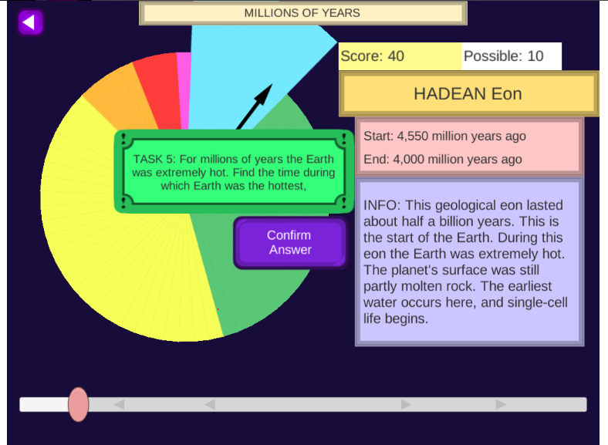
Piecing Together the Puzzle
On the 1st game of this week’s Legends playlist, you had a challenge to complete different tasks related to scale and time.
Yesterday we talked about how scientists used rock strata and index fossils to give us “pieces” of the past.
Today we are going to put those different pieces together to form our own Geologic Time Scale.

Slide 2
Let’s piece together Earth’s history …
We will go to the hallway to the timeline rope – the long rope you saw me putting up on Tuesday.
Stand against the wall on the opposite side of the hallway QUIETLY.
I will ask for your help in placing event cards (with related items) on the timeline in the correct place.
Pay attention because you will need to remember what you learned for our next activity.
Quick Question: What does “mya” mean?

Slide 3
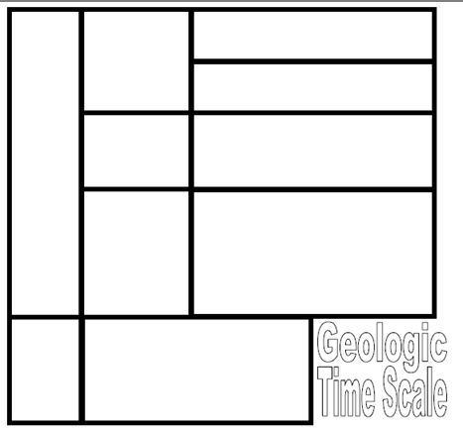
Putting Together the Pieces
Glue the “block” page on page _____.
Glue sideways as close to the left-hand side as possible!
You will need room
to write on the page.

Slide 4
Cut out the PRECAMBRIAN card.
Glue it in the bottom left-hand corner.

Slide 5
Cut out the block with the first THREE EONS listed.
Glue it in the box to the right of PRECAMBRIAN TIME.

Slide 6
Find the box for our current EON – PHANEROZOIC.
Glue it in the top left-hand column.

Slide 7
Where would the other blocks/pieces go?

Slide 8
Check your answers …

Slide 9
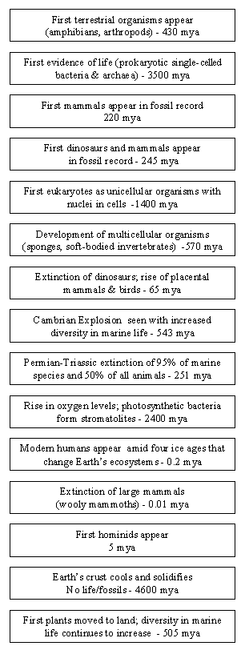
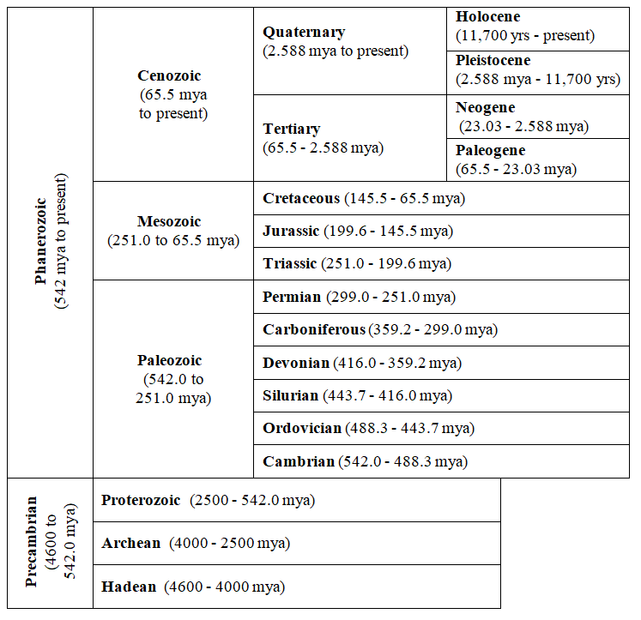
Cut apart all the cards and sort from the oldest at the BOTTOM to the most recent at the TOP.
MOST RECENT
?
Let’s add some events …
OLDEST
3/12/19-3/13/19

Slide 10
Glue the OLDEST event at the bottom.
Draw a line to connect it to the correct place on the time scale.
Continue until you add all the events.
You may use the geologic time scale in the hallway to help you if you are QUIET.

Slide 11
Glue them in order from the oldest at the BOTTOM to most recent at the TOP.
Draw arrows to the correct time period OR use another method to code and organize the slips.

Slide 12
Assignments …
Finish adding all the events to your geologic time scale.
Work on the Earth’s History playlist on Legends – Due Friday
Find something else to do after you are done.

Slide 13
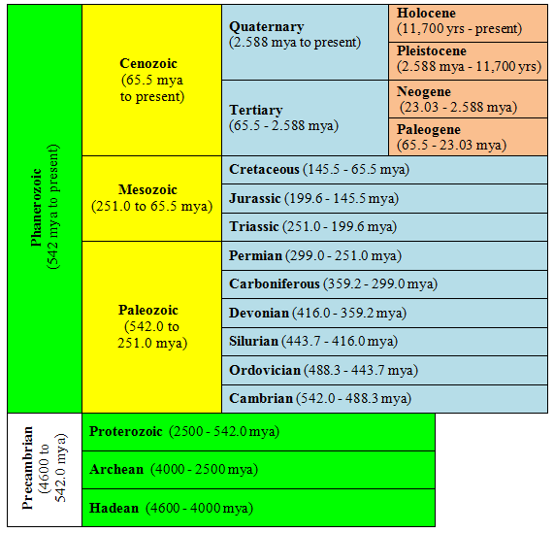
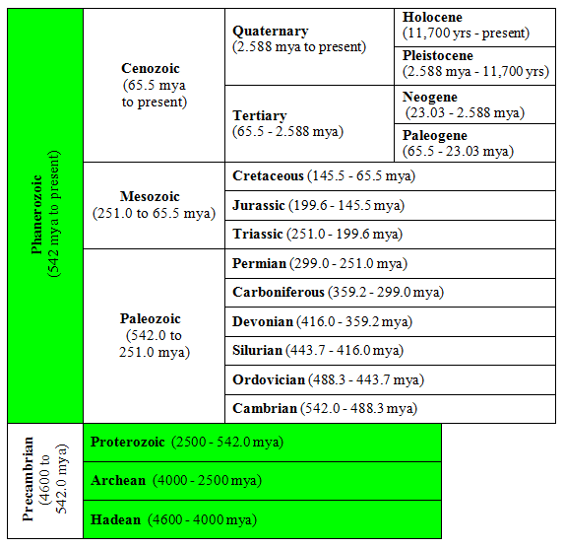
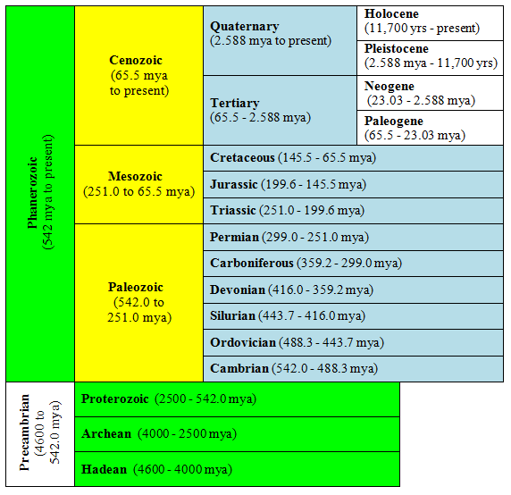
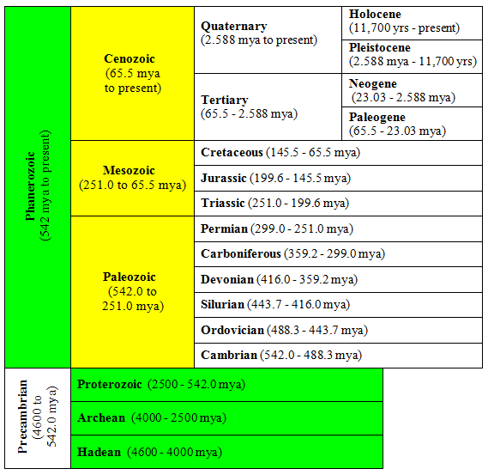
Let’s add to our timescale …
MOST RECENT
EON
ERA
PERIOD
EPOCH
GREEN = EON
YELLOW = ERA
BLUE = PERIOD
ORANGE = EPOCH
=
MOST RECENT
OLDEST
3/14/19

Slide 14
EDPuzzle Assignment
AFTER you have added all the events to your time scale AND finished your Legends playlist …
Sign into EDPuzzle.
Watch the “Brief History of Earth” video.
Add information to your timeline and/or notes that will help you answer the video questions.
Complete the video quiz as you watch the video, which will count for a grade.
Note Quiz over Lesson 3 on Monday!

Slide 15
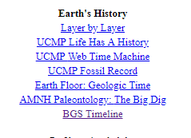
What else has happened?
Each person needs to find ONE event (older than 10,000 years) to add to the hallway timeline. Cannot be an event already in the hallway Cannot be an event on the event cards in your notebook. Use the SS Kid Zone → Earth Science Links to help you
Get a card from the front table & markers to make it pretty.
Write the event on the BLANK SIDE of the card along with the “date”.
Draw a picture that goes with the event.
Put your name on the back.
Show the teacher for a grade and then hang in the hallway.
3/15/19

Slide 16
Things to do …
Finish Legends playlist – E-mail the teacher by 3:30 PM when done.
Finish EDPuzzle (History of Earth video) – Will add grades at the end of the class period
Start studying for the text next week using the vocab sets on mrstomm.com → Assignments
Find other work to do.
Note Quiz over Lesson 3 on Monday!
Unit Test next Thursday!
You may listen to music IF everything above the red line is done!

Slide 17
Think About It
Work with a partner to answer all these questions. Be prepared to share with the class.
Which EON is the longest? Shortest?
How long ago did life begin on Earth?
How did living things change from the time life began to present day?
In which ERA did modern humans appear?
Which came first: marine or terrestrial organisms?
Which came first: prokaryotic or eukaryotic organisms?
3/18/19

Slide 18
What else did you add from the EDPuzzle video – Brief History of Earth?
4.6 = BILLION years 4600=MILLIONS years
Eon → Era → Period → Epoch → Ages
Age of Mammals → Cenozoic (“current” life)
Age of Reptiles → Mesozoic (“middle” life)
Major geologic or biologic events
– Cooling of crust, movement of continents (Pangaea)
– Extinctions (Permian-Triassic) & explosions (Cambrian)
Trilobites (Older) vs. Ammonites (More recent)
Eukaryotes (Cells with a nucleus) vs. Prokaryotes (No nucleus)
Iridium - Element found in Gulf of Mexico; claimed as evidence of asteroid impacting the Earth in this area.

Slide 19
Answer Key

