Slide 1
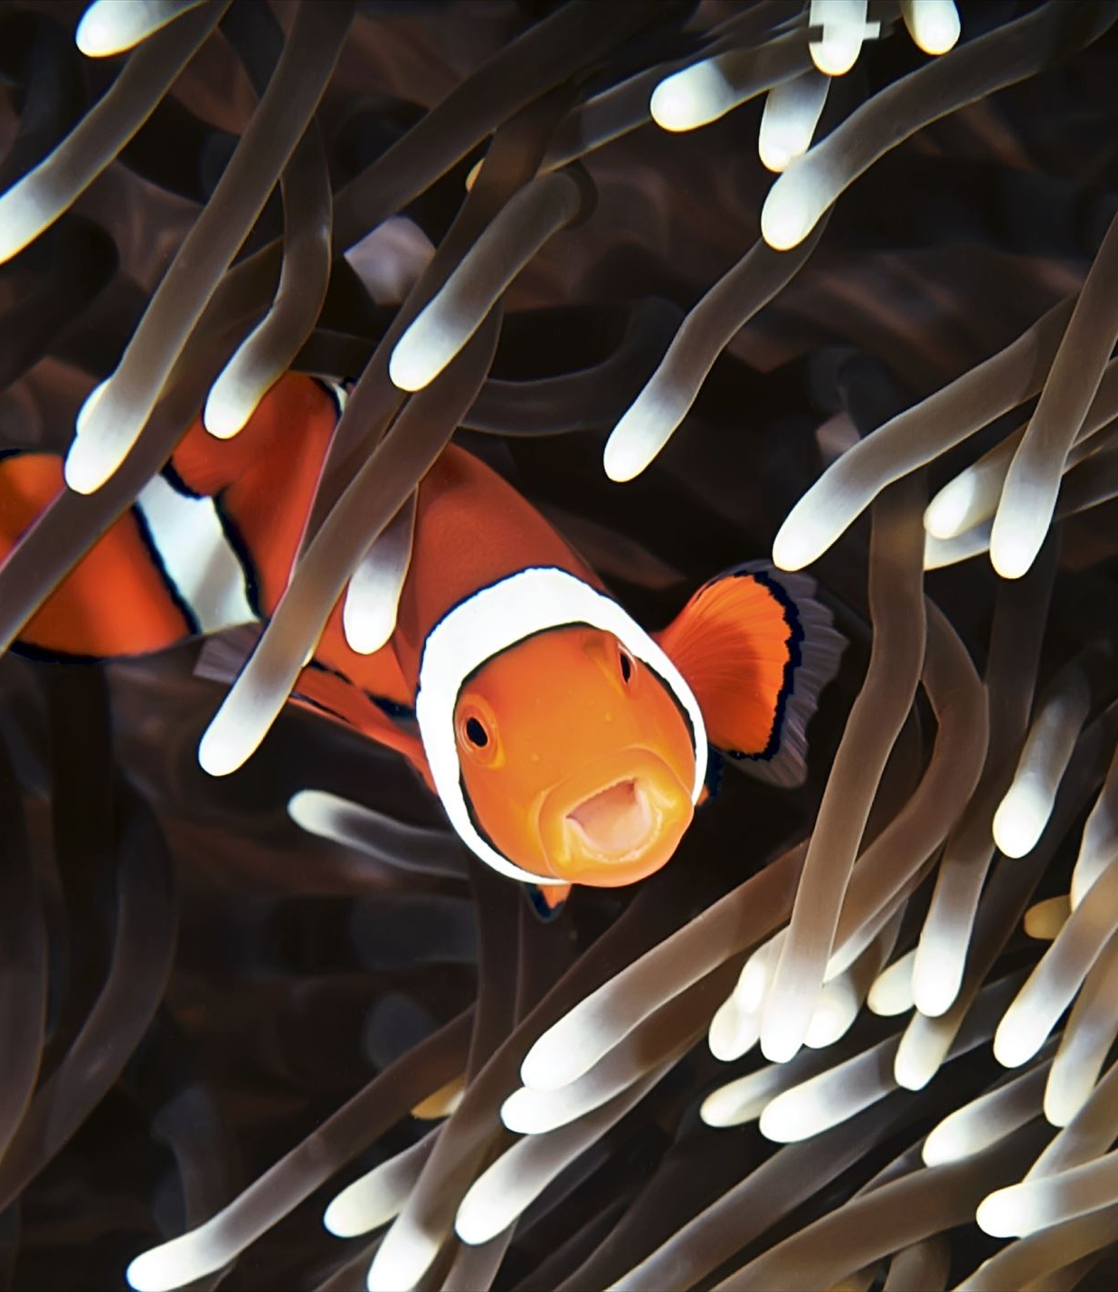
Finding Nemo
Student Digital Slides available at
https://docs.google.com/presentation/d/1htHcnedwNfxsE_y2BHxxBt16houT5os4IRIgBGhzatg/edit?usp=sharing
Ecology Review 2022
K. McPheron & T. Tomm 2022 https://sciencespot.net/

Slide 2
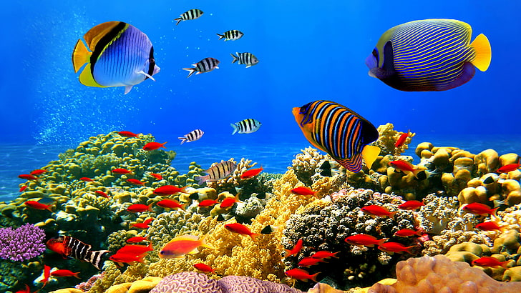
Great Barrier Reef – Australia - 1,429 miles long
Conservation Issues – Pollution, Trash, Invasive species, Coral bleaching
He was injured in a barracuda attack that killed his mom and siblings.
His mom, Coral, liked the name “Nemo.

Slide 3
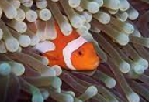
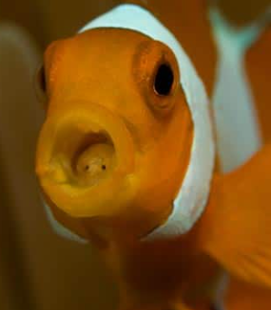
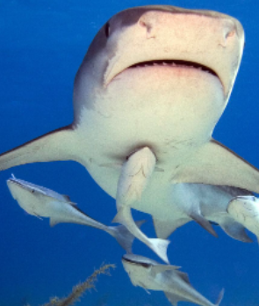
Shrimp +, Nemo +
Whale 0, Barnacle +
Fish Parasites +, Nemo -
Clownfish hides in an anemone for protection. It attracts food for the anemone.
Tongue louse attaches to a Clownfish’s tongue and eats the food the fish would normally eat. The fish starves to death.
Anemone & Clownfish
Tongue Louse & Fish
Remoras attach themselves to the shark to get a free ride and enjoy the food scraps lift behind by the shark. They do not help or hurt the shark.
Shark & Remora

Slide 4
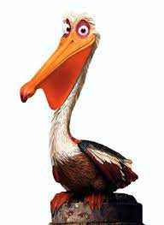
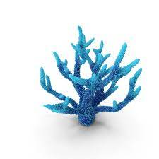
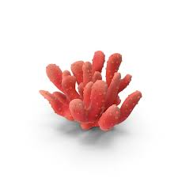
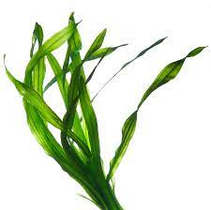
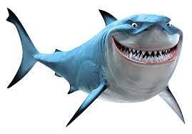
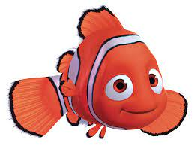
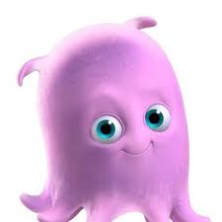
Seaweed
Coral (polyps)
Barracuda
Clownfish
Kelp
Sponges
Pelican
Sea Turtle
Phytoplankton
Zooplankton
Shark
Butterfly fish
NOTE: Different species may be classified as different types of consumers.
Coral (algae)
Starfish
Crabs
Students may add more pictures to complete their webs.

Slide 5
What did you say?
Done with all parts? Turn in on Google Classroom!

