Slide 1
Ecology Unit Teacher Notes
Topics:
Lesson 1: Levels of Organization
Lesson 2: Population Ecology
Lesson 3: Symbiosis (includes activity)
Lesson 4: Case Study – Ponds*
Lesson 5: Food Webs
Activity 1: Food Web Challenge
Activity 2: Pond Water Webs
Activity 3: Food Fight (BrainPop)
Lesson 6: Biodiversity
Activity 1: Think & Link
Activity 2: Madagascar Video
Lesson 7: Succession
Lesson 8: STEM Case – Ecosystem*
Lesson 9: Human Impacts (Lorax Lessons)
* = Explore Learning Gizmos activity
The full Ecology Basics unit is available at https://sciencespot.net/Pages/classbio.html#EcoBasics
This presentation was used to guide classroom lessons and activities for the topic(s) highlighted in the list at right. It is one of several used during my ecology unit, which was developed for 7th & 8th grade students with very little background knowledge of the topics covered in the unit lessons. The unit covered a 14-week period during the fall of 2021, which was a few weeks longer than in the past thanks to the challenges of teaching during a pandemic. The students needed more time to complete the lesson activities and I felt the need to include more discussion time for them to fully develop understanding of a concept before moving to the next topic.
The digital student notebook (with slides for ALL the lessons & activities listed above) is available at https://docs.google.com/presentation/d/15CoXAsd1zWZDy5RCGS37CKUXmfl9M2WAk58-qgwMRjE/edit?usp=sharing I do not assign the entire notebook at the start of the unit. Instead, I create a Master Copy as a “material” on Google Classroom and add the slides as the students need them. They copy the new slides and paste them into their HDSN in the correct spots. You will need to make a copy of the digital file in order to use it with your students. The digital notebook was set up as 14” x 8.5” which can be scaled down to fit a standard page on landscape to allow for printing for students needing paper copies.
T. Tomm Updated 2023 https://sciencespot.net/

Slide 2
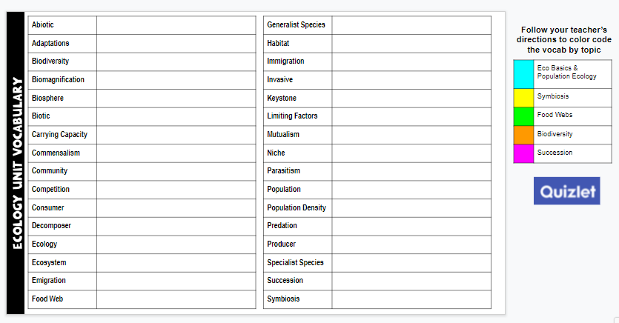
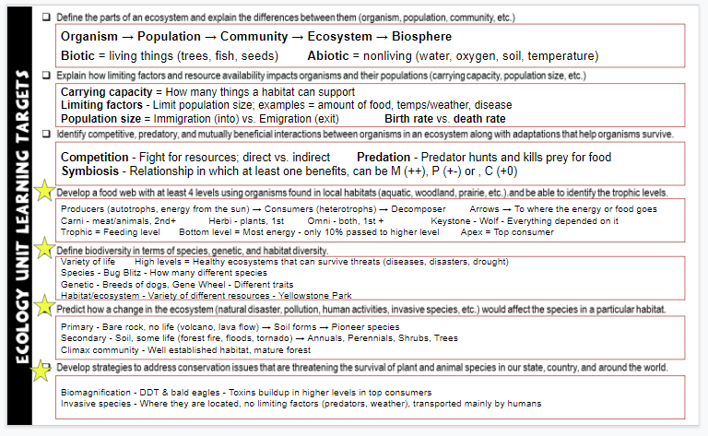
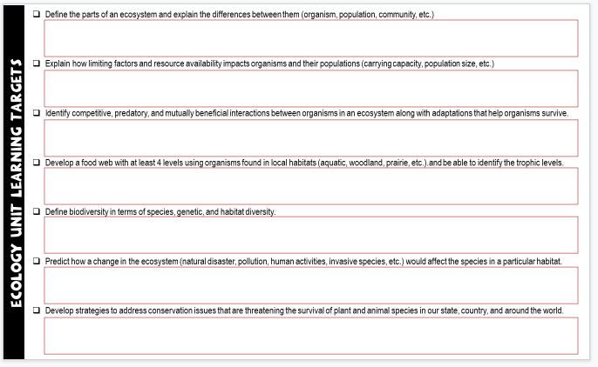
Unit Vocabulary Time
The last slide in the student digital notebook lists the main vocabulary from each lesson. After each topic, I have students color code the terms and then write definitions. All the definitions from the unit are available on the Quizlet page linked below.
Classroom Sample
https://quizlet.com/28845277/ecology-unit-vocabulary-all-terms-flash-cards/
Learning Targets
The next to last slide in the digital notebook is a list of learning targets for the entire unit. Prior to any quiz/test, we review the targets and discuss possible questions that relate to each one. This allows the students to connect the lessons to the learning expectations.
The last learning standard will be included in our Earth Day lessons.

Slide 3
ECOLOGY BASICS
Lesson 1 – Levels of Organization
T. Tomm Updated 2023 https://sciencespot.net/

Slide 4
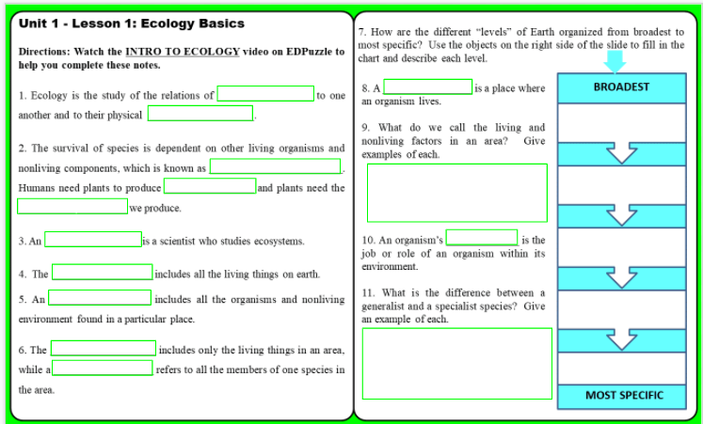
Unit 1 - Lesson 1: Ecology Basics
https://edpuzzle.com/media/57f84197ab116671626aae6c

Slide 5
Directions: Watch the INTRO TO ECOLOGY video on EDPuzzle to help you complete these notes.
1. Ecology is the study of the relations of _________________ to one another and to their physical ___________________.
2. The survival of species is dependent on other living organisms and nonliving components, which is known as ________________________. Humans need plants to produce _____________ and plants need the __________ ____________ we produce.
3. An _________________ is a scientist who studies ecosystems.
ORGANISMS
ENVIRONMENT
INTERDEPENDENCE
OXYGEN
CARBON DIOXIDE
ECOLOGIST

Slide 6
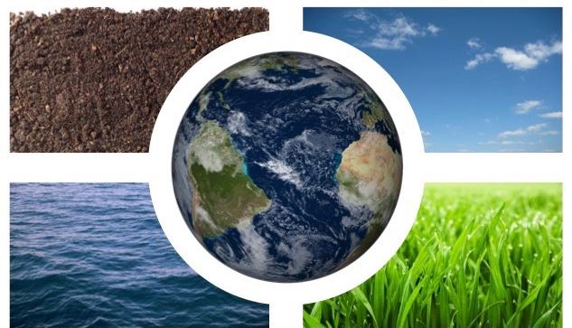
4. The __________________ includes all the living things on earth.
BIOSPHERE
Geo = Earth GEOSPHERE
Atmo = Air ATMOSPHERE
Challenge: What are the other “spheres” on Earth?
Add the red terms (& definitions) to your notes.
HINT: Any info in yellow boxes needs to be added to your notes! You may see them on a note quiz!
HYDROSPHERE Hydro = water
BIOSPHERE Bio = Life
https://ib.bioninja.com.au/options/option-c-ecology-and-conser/c3-impacts-of-humans-on/earth-spheres.html

Slide 7
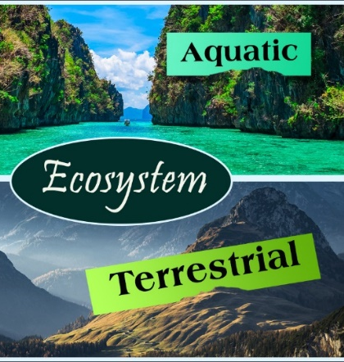
5. An __________________ includes all the organisms and nonliving environment found in a particular place.
6. The ___________________ includes only the living things in an area, while a __________________ refers to all the members of one species in the area.
ECOSYSTEM
AQUATIC = WATER
Marine - Oceans
Estuaries – Boundary of ocean and freshwater
Freshwater – Ponds, rivers, streams, lakes, marsh, etc.
TERRESTRIAL = LAND
Forest, mountain, desert, tundra, grassland, prairie, urban
Add to notes →
COMMUNITY
POPULATION

Slide 8
#7 - Levels of Organization
BROADEST
Challenge: Find images to create a representation of each level. Create a display to the right of your slide.
MOST SPECIFIC

Slide 9
8. A ________________ is a place where an organism lives.
9. What do we call the living and nonliving factors in an area? Give examples of each.
HABITAT
A habitat provides food, water, shelter, and space
BIOTIC – Living things (Could be alive or dead)
ABIOTIC – Nonliving things (Never alive)
How are the resources in the school garden classified: ABIOTIC or BIOTIC
Soil Plants Flowers Water
Birds Insects Seeds Worms
Air Rocks Mulch Sunlight
A
B
B
A
B
B
B
B
A
A
B
A
Add examples to your notes!

Slide 10
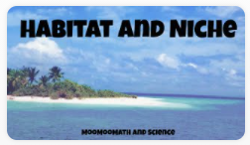
10. The job or role of an organism within its environment is called its __________.
NICHE
Watch the video →
Explain it: What is the difference between a habitat and a niche?
HABITAT → Where an organism lives
NICHE→ Role an organism has, it’s job in the habitat
Give an example using the Galapagos Islands and the finches.
Habitat → Islands
Finches → Same habitat, but eat different seeds and help to spread different plants

Slide 11
11. What is the difference between a generalists and a specialist? Give an example of each.
Generalist species can survive in a variety of habitats.
Example: Pigs would be generalist species since they eat a lot of different things.
Specialist species are very sensitive to changes in their habitats and would have a harder time surviving.
Example: A panda would be a specialist species since it eats only bamboo.
Which of these organisms would be specialist species?
Raccoon Canada Lynx Koala
Monarch Venus Flytrap Cockroach
Human Tiger Salamanders Coyotes
G
S
S
S
S
G
G
S
G

Slide 12
ECOLOGY BASICS
Lesson 2 - Part A: Biological Carrying Capacity
Video Link: https://edpuzzle.com/media/57ff8fb3463104de3e7cfd7b
T. Tomm Updated 2023 https://sciencespot.net/

Slide 13
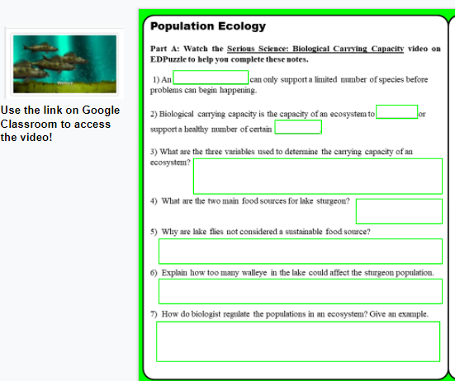
Ecology Unit 1 Lesson 2 Notes – Part A
1st - Watch the POPULATION ECOLOGY video – link on GC.
2nd – Complete Part B on the LEFT side of SLIDE 3.
Video Link: https://edpuzzle.com/media/57ff8f3080ff69ee3e14fc45

Slide 14
Serious Science: Biological Carrying Capacity
1) An _________________ can only support a limited number of species before problems can begin happening.
2) Biological carrying capacity is the capacity of an ecosystem to _________ or support a healthy number of certain __________.
3) The three variables used to determine the carrying capacity are ______________ of foods, ________________ foods, and ________________ for food.
4) What are the two main food sources for lake sturgeon? _________________ & __________________
ECOSYSTEM
CARRY
SPECIES
ABUNDANCE
SUSTAINABLE
COMPETITION
LAKE FLIES (Larva/pupa)
GIZZARD SHAD
Lake fly larva provide an abundant and sustainable food source for sturgeons.
TRUE OR FALSE?

Slide 15
5) Why are lake flies not considered a sustainable food source?
6) Explain how too many walleye in the lake could affect the sturgeon population.
7) How do biologist regulate the populations in an ecosystem? Give an example.
They are not available year-round.
Walleye also eat shad. If there were too many of them, they would eat a lot of shad and leave less for the sturgeon.
They set a limit on how many fish can be caught during a certain period.
Example: if there are too many walleye, the limit on them would be increased to reduce how many there are.

Slide 16
Monarch Butterflies - What factors might affect the garden's carrying capacity? Explain.
1.
2.
3.
Add a text box to the side of your slide.
Amount of milkweed for caterpillars
Amount of flowers for nectar for adult butterflies
Number of predators that might eat caterpillars and adults
How would these affect Monarch populations?
Habitat destruction
Bad weather
Increase in predators
Invasive species
?
?
Time to identify some bugs!

Slide 17
ECOLOGY BASICS
Lesson 2 - Part B: Population Ecology
Video Link: https://edpuzzle.com/media/57ff8f3080ff69ee3e14fc45
T. Tomm Updated 2023 https://sciencespot.net/

Slide 18
Ecology Unit 1 Lesson 2 Notes – Part B
1st - Watch the POPULATION ECOLOGY video – link on GC.
2nd – Complete Part B on the RIGHT side of SLIDE 3.
Video Link: https://edpuzzle.com/media/57ff8f3080ff69ee3e14fc45

Slide 19
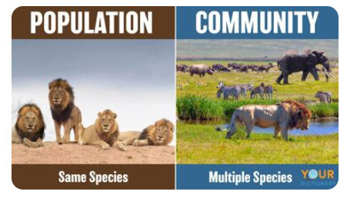
Slide #3 - Part C: Watch the Population Ecology video to complete this section.
1. What are the different types of ecology?
POPULATION studies populations – one species
COMMUNITY studies communities – multiple species
ECOSYSTEM studies all living and nonliving things – multiple species plus the abiotic factors (soil, water, temperature, air, etc.)

Slide 20
2. What is population density?
THE NUMBER OF ORGANISMS IN A SPECIFIC AREA.
What can cause it to increase or decrease?
Organisms moving into or out of an area
Migration: The seasonal movement of animals to areas with warmer temperatures, such as Monarchs moving to Mexico. They emigrate from our area to immigrate into populations in Mexico.
I = INTO
IMMIGRATION –Move INTO an area.
E = EXIT
EMIGRATION –Move OUT of an area.
BIRTH RATE = # of births VS. DEATH RATE = # of deaths
Birth rate = Death Rate =
Birth rate > Death rate = ____________
Birth rate < Death rate = ____________
STAYS THE SAME
INCREASE
DECREASE
Mosquitoes: 2000 in 2 weeks
THINK ABOUT IT: How does the birth rate of mosquitoes compare to a rhino?
Rhinos: 5 in a lifetime (40 years)

Slide 21
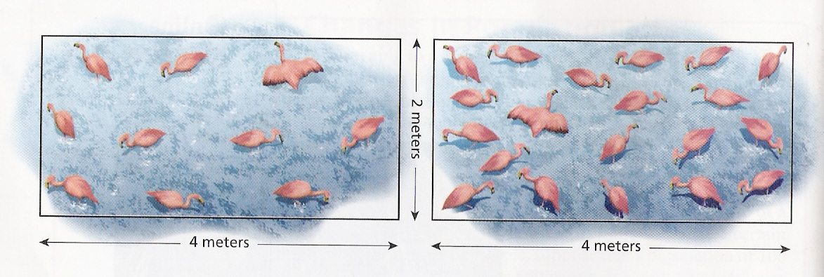
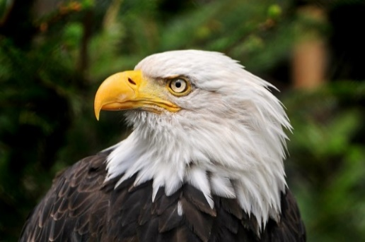
Question A: Which population has the highest density: A or B?
Population Density =
^{# of animals÷} ^{area}
A
B
10 ÷ 8 = 1.25 flamingoes/m²
20 ÷ 8 = 2.5 flamingoes/m²
Question B: If a total of 56 bald eagles are counted in 4 acres of land, what is the density of the bald eagle population?
56 ÷ 4 =
14 eagles/acre
The higher the density, the more competition there will be. Competition = Struggle for resources (food, water, space, etc.)
This Photo by Unknown Author is licensed under CC BY-NC-ND

Slide 22
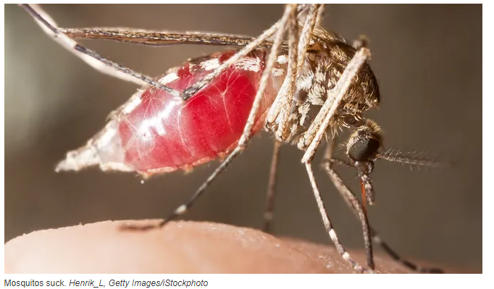
3. _____________ factors determine a population’s ability to grow, such as temperature, habitat needs, food, reproduction, etc.
4. Besides a mate, what do female mosquitoes need to reproduce?
LIMITING
Limiting factors → Limit growth
BLOOD FROM A VERTEBRATE
WARM TEMPERATURES
STAGNANT WATER
THINK ABOUT IT: Which of these factors lead to the population explosion in Dallas in 2012 and not 2013?
STAGNANT WATER (more rain in 2012)

Slide 23
5. The ______________ capacity is the number of individuals a habitat can sustain based on the resources it has available.
6. What is the difference between density-independent and density-dependent?
7. Exponential ______________ means that a population will grow exponentially up to a point in which it can’t be sustained.
CARRYING
Dependent depends on the # of animals, while Independent does not.
Examples: 1) Colder temperatures that would slow reproduction
2) More mosquitoes leads to more bats
3) Storm washing away stagnant water
INDEPENDENT
DEPENDENT
INDEPENDENT
GROWTH

Slide 24
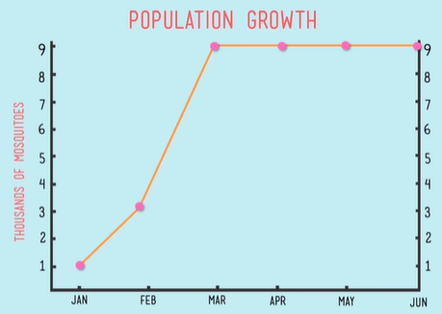
8. Based on the January → June graph, the carrying capacity for mosquitoes in this habitat is __________.
9000
Notice how the population goes from 1000 → 3000 → 9000

Slide 25
9. What was the rate of growth for the Dallas mosquito population? _______
999
Birth Rate = 2000 x 50 = 100000 Death Rate = 100
100000 – 100 = 999
100
Growth Rate
Starting Population
Human population rate of growth = 105%
https://www.worldometers.info/world-population/#:~:text=Population%20in%20the%20world%20is,81%20million%20people%20per%20year
.

Slide 26
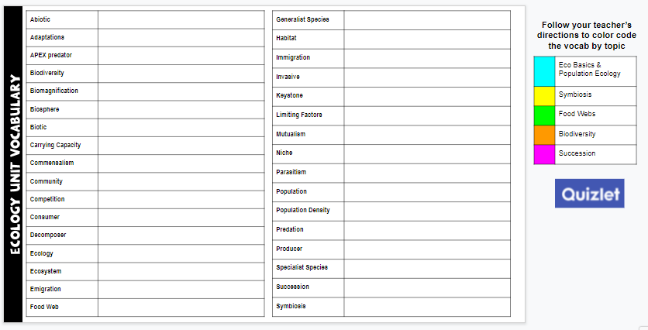
Vocabulary Time
Which terms were discussed in Lesson 1 & 2? Use the bucket tool to shade in the boxes with those terms and then write a definition for each one.
https://quizlet.com/28845277/ecology-unit-vocabulary-all-terms-flash-cards/
You do not have to write definitions for all terms – just those you shaded that were in our first two lessons.

Slide 27
Ecology
Basics
Teacher Note: You will need to have access to this activity on the Explore Learning website. Once you have an account and have added classes & students, you will need to update the following slides to reflect the information they will need to log in.
If you do not have access, delete the slides in this presentation and on the digital notebook version.
Lesson 1C: Pond Case Study
Simulation available through Gizmos from Explore Learning.
Introduction (Left side)

Slide 28
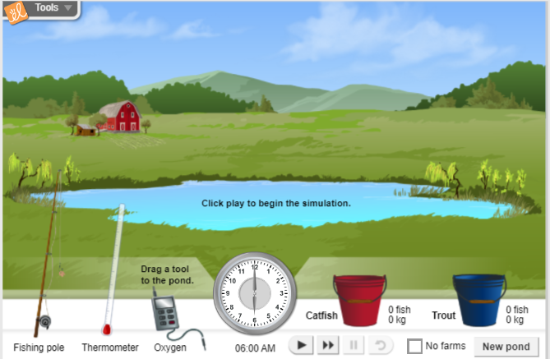
Lesson 4 Case Study – Pond Ecosystem
Part A Part B Ecosystem Builder

Slide 29
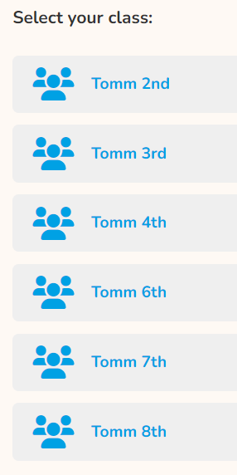
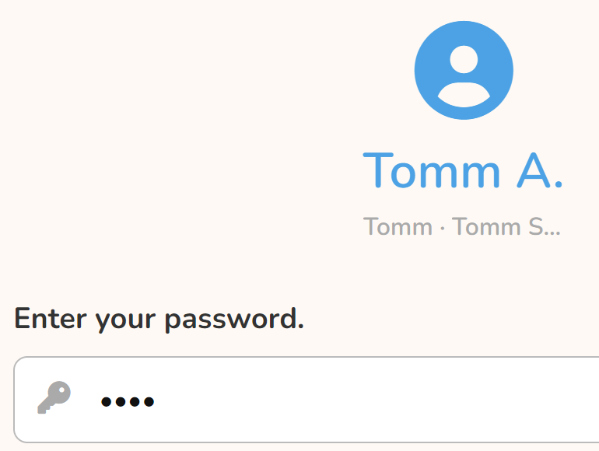
Case Study – Pond Ecosystem
Follow these directions to login.
Teacher Note: You will need to have access to this activity on the Explore Learning website. Once you have an account and have added classes & students, you will need to update the following slides to reflect the information they will need to log in.
Use this username
ttomm2023
Click your class period
Click your name
126S#
WAIT for everyone to get logged in!
126S12345

Slide 30
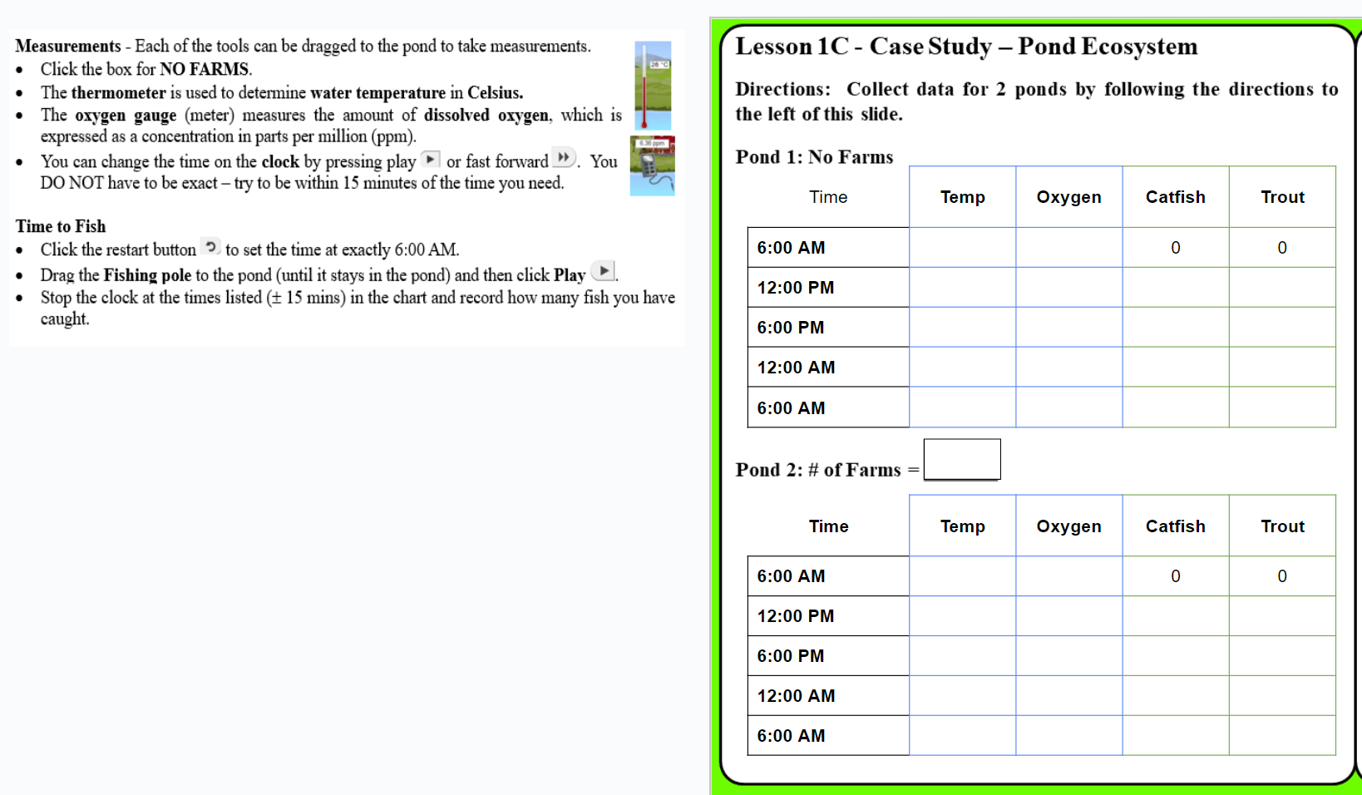
Slide 4 – Left Side
Collecting Data – Follow the direction to the left of the slide to record water temperature and oxygen concentration. You will also need to keep track of the # of fish you catch for each pond.
Click NEW POND and choose one with farms.

Slide 31
Slide 4 – Right Side
Discussion Questions – Use your observations and data to answer the questions. Be prepared to discuss your answers in class.
Try for a record! Describe the pond that was the best fishing spot!

Slide 32
Ecology
Basics
Teacher Note: You will need to have access to this activity on the Explore Learning website. Once you have an account and have added classes & students, you will need to update the following slides to reflect the information they will need to log in.
If you do not have access, delete the slides in this presentation and on the digital notebook version.
Lesson 3: Pond Case Study
Simulation available through Gizmos from Explore Learning.
Discussion Questions (Right side)

Slide 33
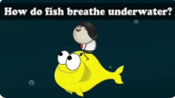
Not in your notebook!
Think About It
1) Animals that live on land obtain their oxygen from the air. How do fish and other animals that live in water get their oxygen?
Gills
2) What gas is dissolved in soda to make it bubbly?
Carbon Dioxide (CO₂)
3) What happens to an open bottle of soda that is allowed to sit for awhile?
It will go “flat” – all the dissolved CO₂ will separate out of the solution.
4) Does the temperature of the soda affect what happens?
Warm soda will lose CO₂ faster than a cold soda.

Slide 34
Open your Ecology HDSN & go to Slide 4.
Done? You may fix or correct your answers.
Not done? Close your laptop and listen. You will need to finish it and see the teacher for the class notes.

Slide 35
Discussion Questions – Use your observations and data to answer these questions.
1) List 3 biotic and 3 abiotic factors in a pond ecosystem.
Biotic → Living things
Abiotic → Nonliving things
Catfish
Trout
Other fish
Algae
Plants
Insects & larvae/nymphs
Frogs/tadpoles
Birds
Snakes
Water
Oxygen/air
Temperature
Sunlight
Soil
Rocks
Chemical compounds from
fertilizers & other chemicals
Most popular answers

Slide 36
2) How does the oxygen concentration change over 24 hours? Why?
Time | Temp | Oxygen
6:00 AM | 15 | 5.93
12:00 PM | 17 | 7.52
6:00 PM | 19 | 9.10
12:00 AM | 16 | 7.56
6:00 AM | 14 | 5.69
Time | Temp | Oxygen
6:00 AM | 19 | 5.37
12:00 PM | 22 | 6.95
6:00 PM | 23 | 8.37
12:00 AM | 21 | 6.90
6:16 AM | 19 | 5.37
Time | Temp | Oxygen
6:00 AM | 23 | 5.00
12:00 PM | 26 | 6.44
6:00 PM | 27 | 7.88
12:00 AM | 25 | 6.50
6:00 AM | 23 | 5.00
What happens?
Oxygen levels → Increase during the day and decrease down at night.
Hint: What is taking place when the sun is out?
Why?
Day → Algae & plants make oxygen by photosynthesis
Night → Animals use up oxygen, no photosynthesis

Slide 37
3) How does water temperature affect its ability to hold oxygen?
Warm water holds less dissolved oxygen than cold water.
Calculate the average temperature and oxygen concentration for each pond listed below.
Which pond is warmer?
Which pond has a lower average concentration?
POND A | Temp | Oxygen
6:00 AM | 15 | 5.93
12:00 PM | 17 | 7.52
6:00 PM | 19 | 9.10
12:00 AM | 16 | 7.56
6:00 AM | 14 | 5.69
POND B | Temp | Oxygen
6:00 AM | 23 | 5.00
12:00 PM | 26 | 6.44
6:00 PM | 27 | 7.88
12:00 AM | 25 | 6.50
6:00 AM | 23 | 5.00
Pond B
Pond B
16.2
24.8
Average Temp = _____
Average Concentration = _____
Average Temp = _____
Average Concentration = _____
7.16
6.16

Slide 38
4) How does oxygen concentration affect the fish that live in a pond?
NO FARMS | Temp | Oxygen | Catfish | Trout
6:00 AM | 15 | 5.93 | 0 | 0
12:00 PM | 17 | 7.52 | 3 | 5
6:00 PM | 19 | 9.10 | 5 | 8
12:00 AM | 16 | 7.56 | 6 | 14
6:00 AM | 14 | 5.69 | 9 | 17
Look at your data …
Most fish overall?
More catfish?
More trout?
Higher oxygen concentration?
1 FARM | Temp | Oxygen | Catfish | Trout
6:00 AM | 19 | 4.77 | 0 | 0
12:00 PM | 21 | 6.10 | 2 | 3
6:00 PM | 23 | 7.40 | 6 | 5
12:00 AM | 20 | 6.18 | 10 | 8
6:00 AM | 19 | 4.81 | 13 | 9
Generalist vs specialist
Trout need more oxygen, while catfish can survive with less oxygen.

Slide 39
5) How does the presence of farms affect the temperature or oxygen levels in a pond? Why?
1 FARM | Temp | Oxygen | Catfish | Trout
6:00 AM | 19 | 4.77 | 0 | 0
12:00 PM | 21 | 6.10 | 2 | 3
6:00 PM | 23 | 7.40 | 6 | 5
12:00 AM | 20 | 6.18 | 10 | 8
6:00 AM | 19 | 4.81 | 13 | 9
4 FARMS | Temp | Oxygen | Catfish | Trout
6:00 AM | 27 | 2.69 | 0 | 0
12:00 PM | 30 | 3.50 | 4 | 0
6:00 PM | 31 | 4.27 | 9 | 0
12:00 AM | 29 | 3.51 | 14 | 0
6:00 AM | 27 | 2.69 | 17 | 0
The more farms you had, the lower your oxygen levels.
Why?
Fertilizers and other chemicals can lower oxygen levels.
High levels of run off = More sediments in the pond & less light reaching the plants on the bottom

Slide 40
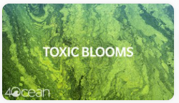
What causes a toxic bloom?
Fertilizers cause algal blooms
Bacteria decompose dead algae & use up oxygen
Low oxygen kills fish
What other places contribute to the problem?
Yards, golf courses, parks, factories

Slide 41
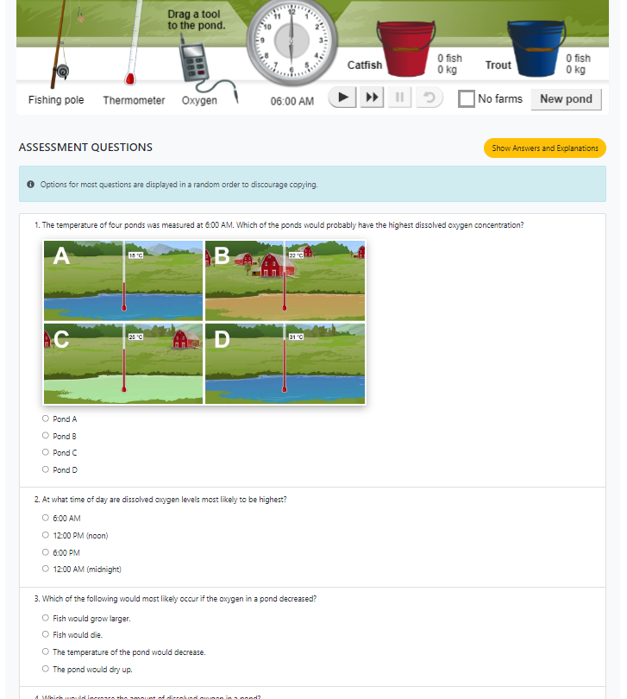
LOG IN
Open the activity and then click LAUNCH
ttomm2023
Click the BLUE ARROW.
Click your class
Click your name
Use your 126S# as the password.
Scroll down to find the 5 questions.
?
?
How did you do?
Extra time? Try fishing again, look at the Bio Blitz pictures, or work on other work.

Slide 42
Challenge: Which pond will produce the best results? Give it a try! Describe what worked the best for you and your results in the text box to the right of this slide.
What temperature worked best – warmer or colder?
Did you want to start with a higher or lower oxygen concentration?
Who was able to catch more trout than catfish?

